Slide 1

The Racial Disparities of police Killings
RayShawn Williams
Prof. Edmund Ameyaw
DATA 303

Slide 2
Problem Framing
Research Question: Are people of color target by the ”justice system”
Objectives:
Prove racial disparities
Provide ways to reduce police killings by use of force
Black individuals are disproportionately affected by police shootings relative to their population size.
Police training in the US does not properly prepare officers for working in the field.
The presence of a weapon does not explain racial disparities in police killings.
What are the key factors that predict fatal encounters.

Slide 3
Dataset information
Data Collection
id | date | threat_type | flee_status | armed_with | state | age | gender | race | mental_ illness_ related
3 | 1/2/15 | point | not | gun | WA | 53 | male | A | TRUE
4 | 1/2/15 | point | not | gun | OR | 47 | male | W | FALSE
5 | 1/3/15 | move | not | unarmed | KS | 23 | male | H | FALSE
8 | 1/4/15 | point | not | replica | CA | 32 | male | W | TRUE
9 | 1/4/15 | point | not | other | CO | 39 | male | H | FALSE
11 | 1/4/15 | attack | not | gun | OK | 18 | male | W | FALSE
13 | 1/5/15 | shoot | car | gun | AZ | 22 | male | H | FALSE
15 | 1/6/15 | point | not | gun | KS | 35 | male | W | FALSE
16 | 1/6/15 | accident | not | unarmed | IA | 34 | female | W | FALSE
17 | 1/6/15 | point | not | replica | PA | 47 | male | B | FALSE
19 | 1/6/15 | attack | not | knife | CA | 25 | male | W | FALSE
21 | 1/7/15 | point | not | gun | TX | 31 | male | B | FALSE
22 | 1/7/15 | threat | not | knife | OH | 41 | male | B | TRUE
25 | 1/7/15 | point | car | gun | IA | 30 | male | W | FALSE
Name: Fatal Police Shooting Data
Source: National database for police involved shootings
Entry count is11287 entries in 10 years.
Features: Race, Date, Threat Type, Flee Status, Armed With, State, Age, Gender, Mental Illness related, Body Camera, Longitude, Latitude, City, County, and race source
TC
Armed With
Race Source
0

Slide 4
Research & Justifications
Models do reveal that Black individuals are disproportionately targeted, even when unarmed (Chaney & Robertson, 2015).
Police training requirements differ significantly by state (Go Law Enforcement, 2024; Training Reform, n.d.).
Georgia, requires only1/3 of the national highest training hours required (WGXA, 2025).
War on drugs targeted people and communities of color in states such as CA, NY, IL, TX, GA and more.
Floyd v. The city of NY forced to NY Implement reforms on on training stop and frisk and more (Shira A. Scheindlin 2013).
Research shows that Black males are 2.0 times more likely to be killed by police compared to White individuals. (Clark Merefield)
Previous research states that classes such as socio economic class being added could contribute to the ML models ability to predict the data

Slide 5
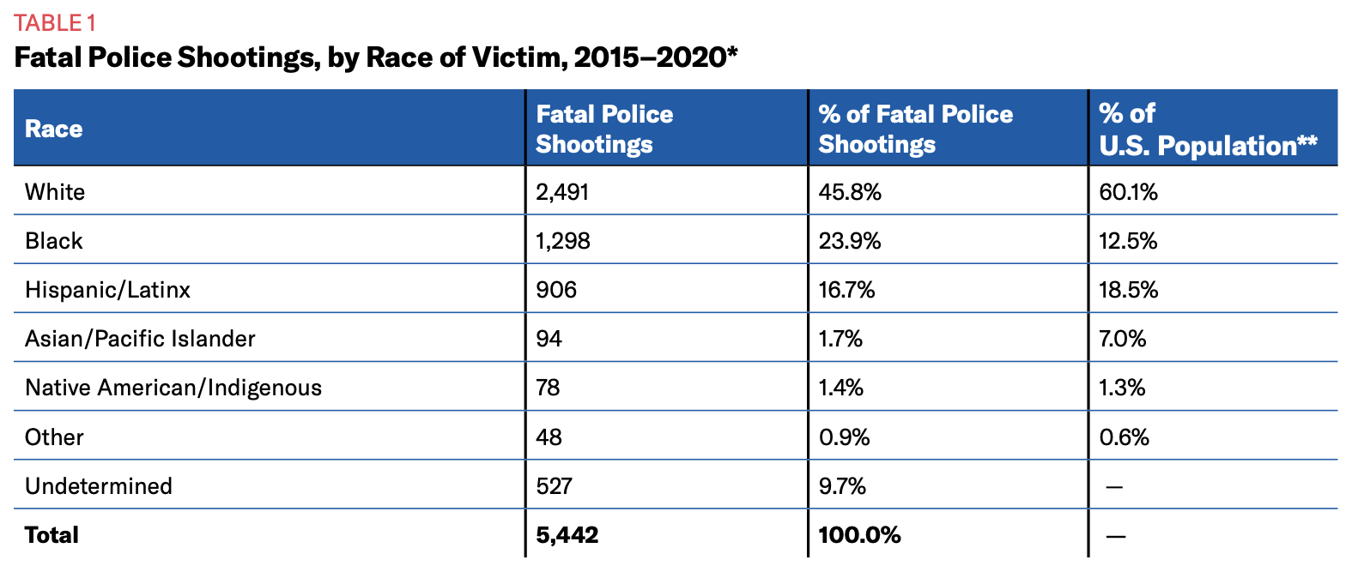

Slide 6

Race Distribution Count

Slide 7
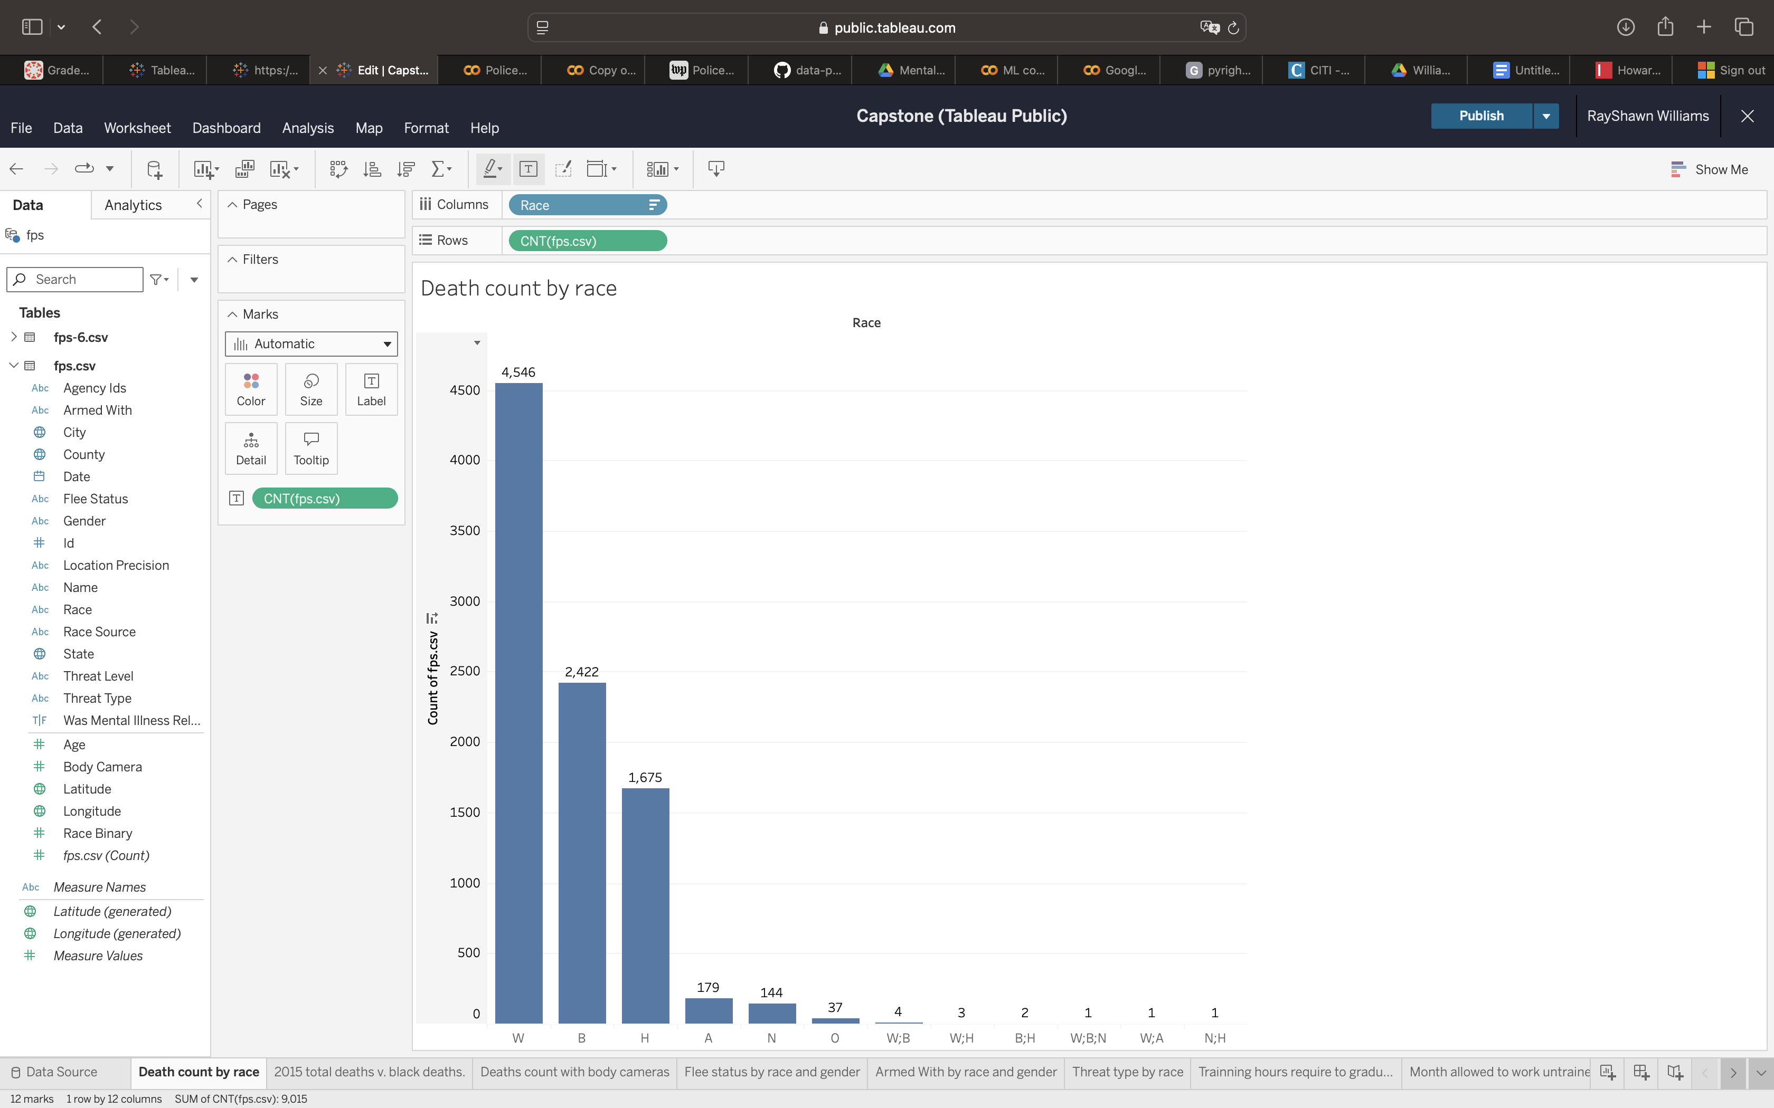

Slide 8
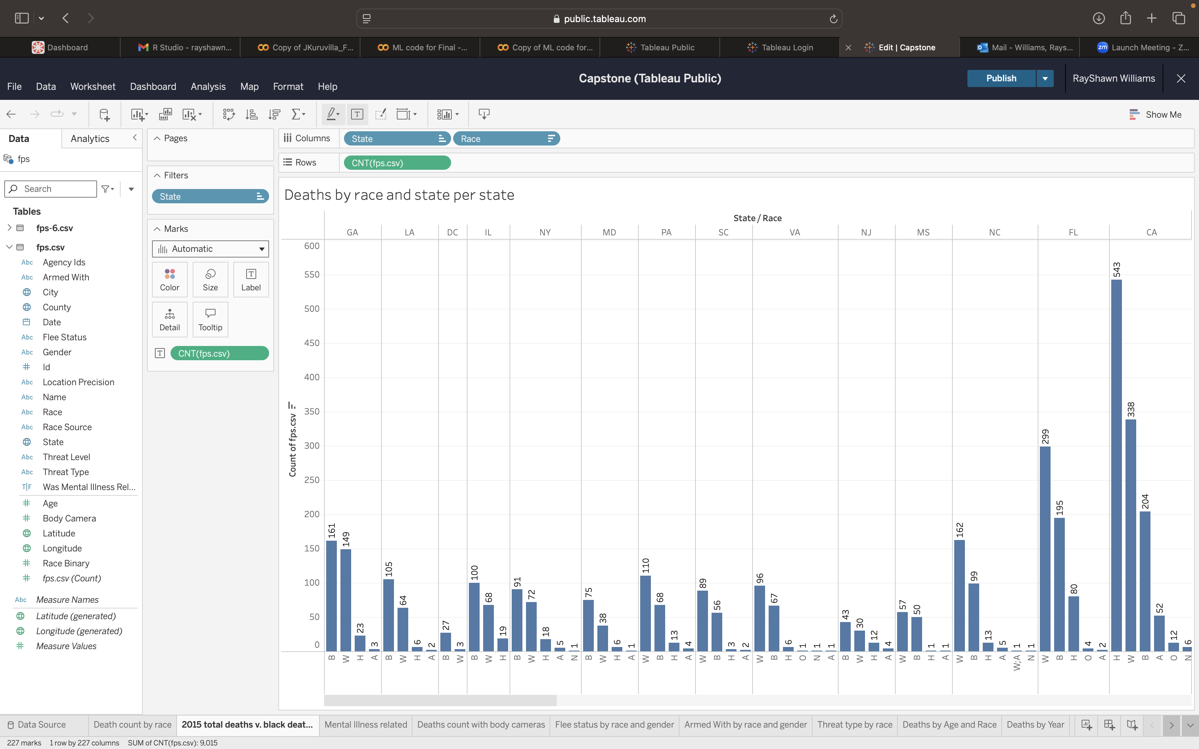

Slide 9
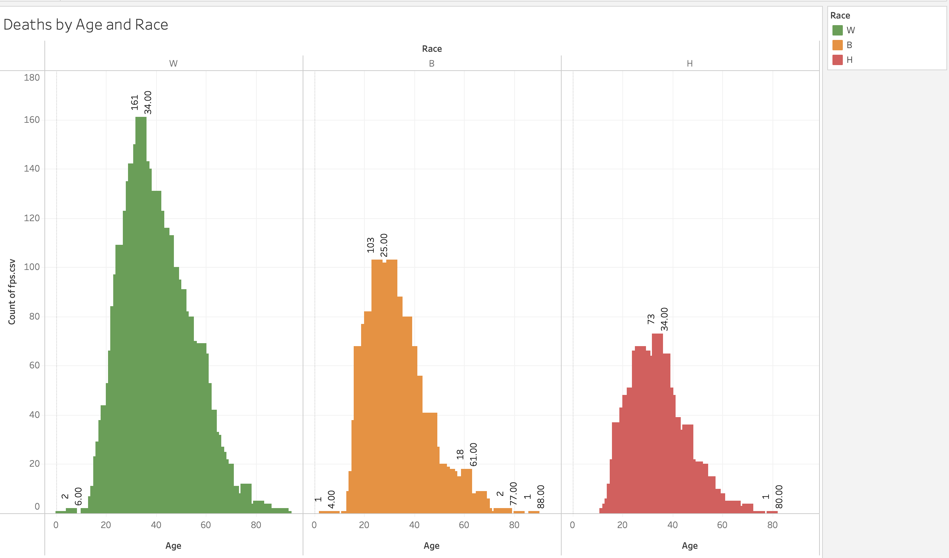

Slide 10
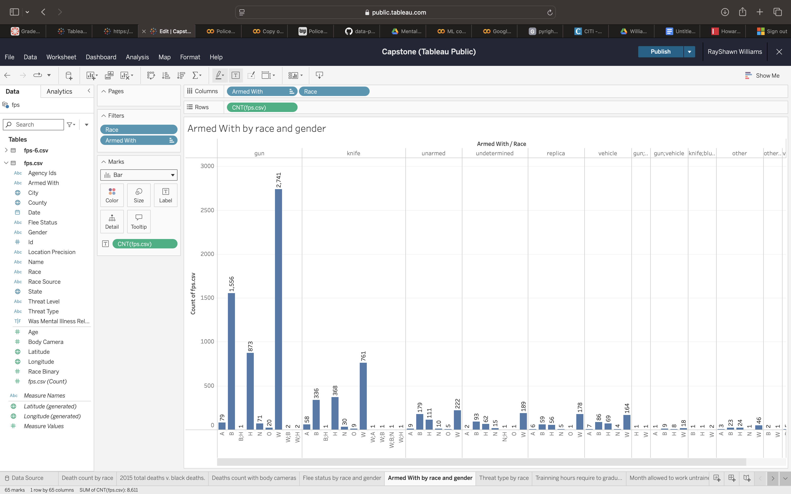

Slide 11
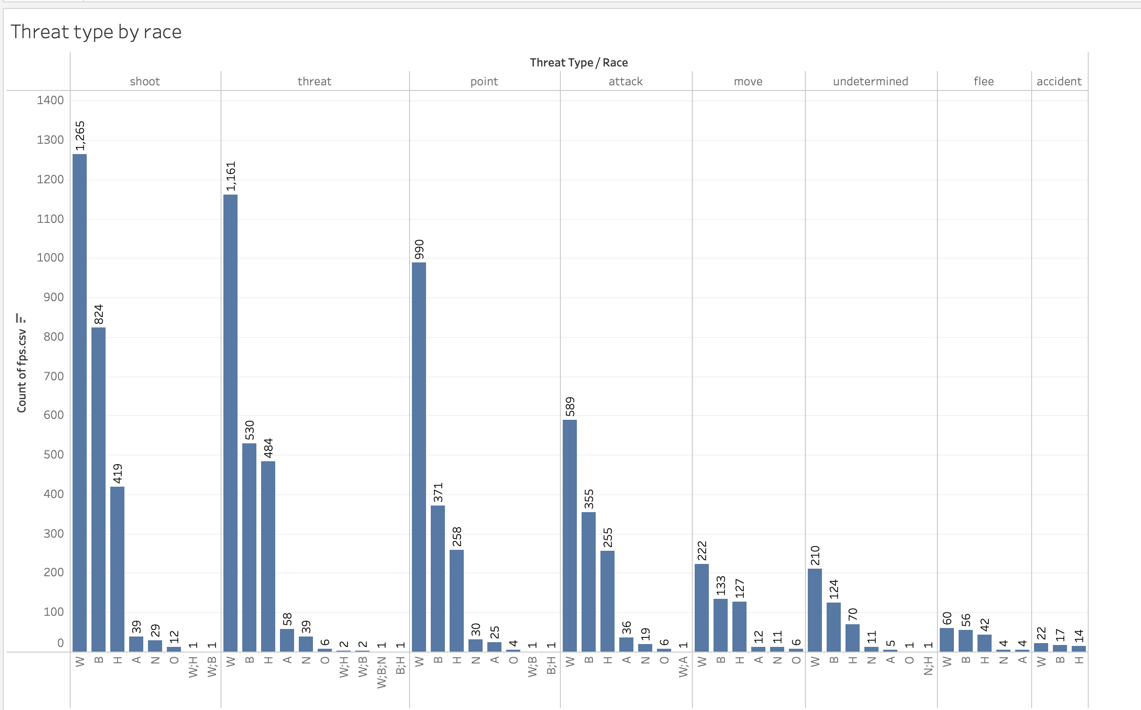

Slide 12
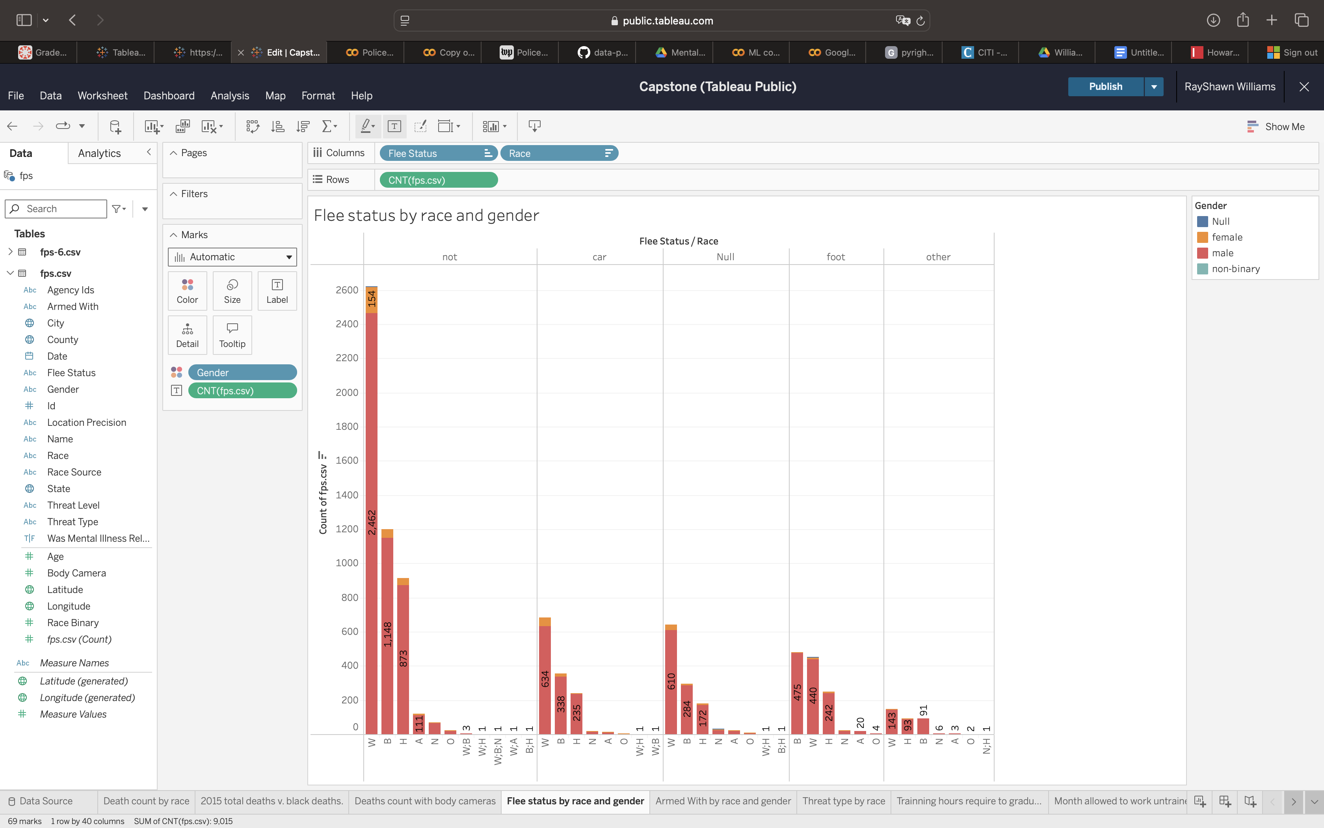

Slide 13
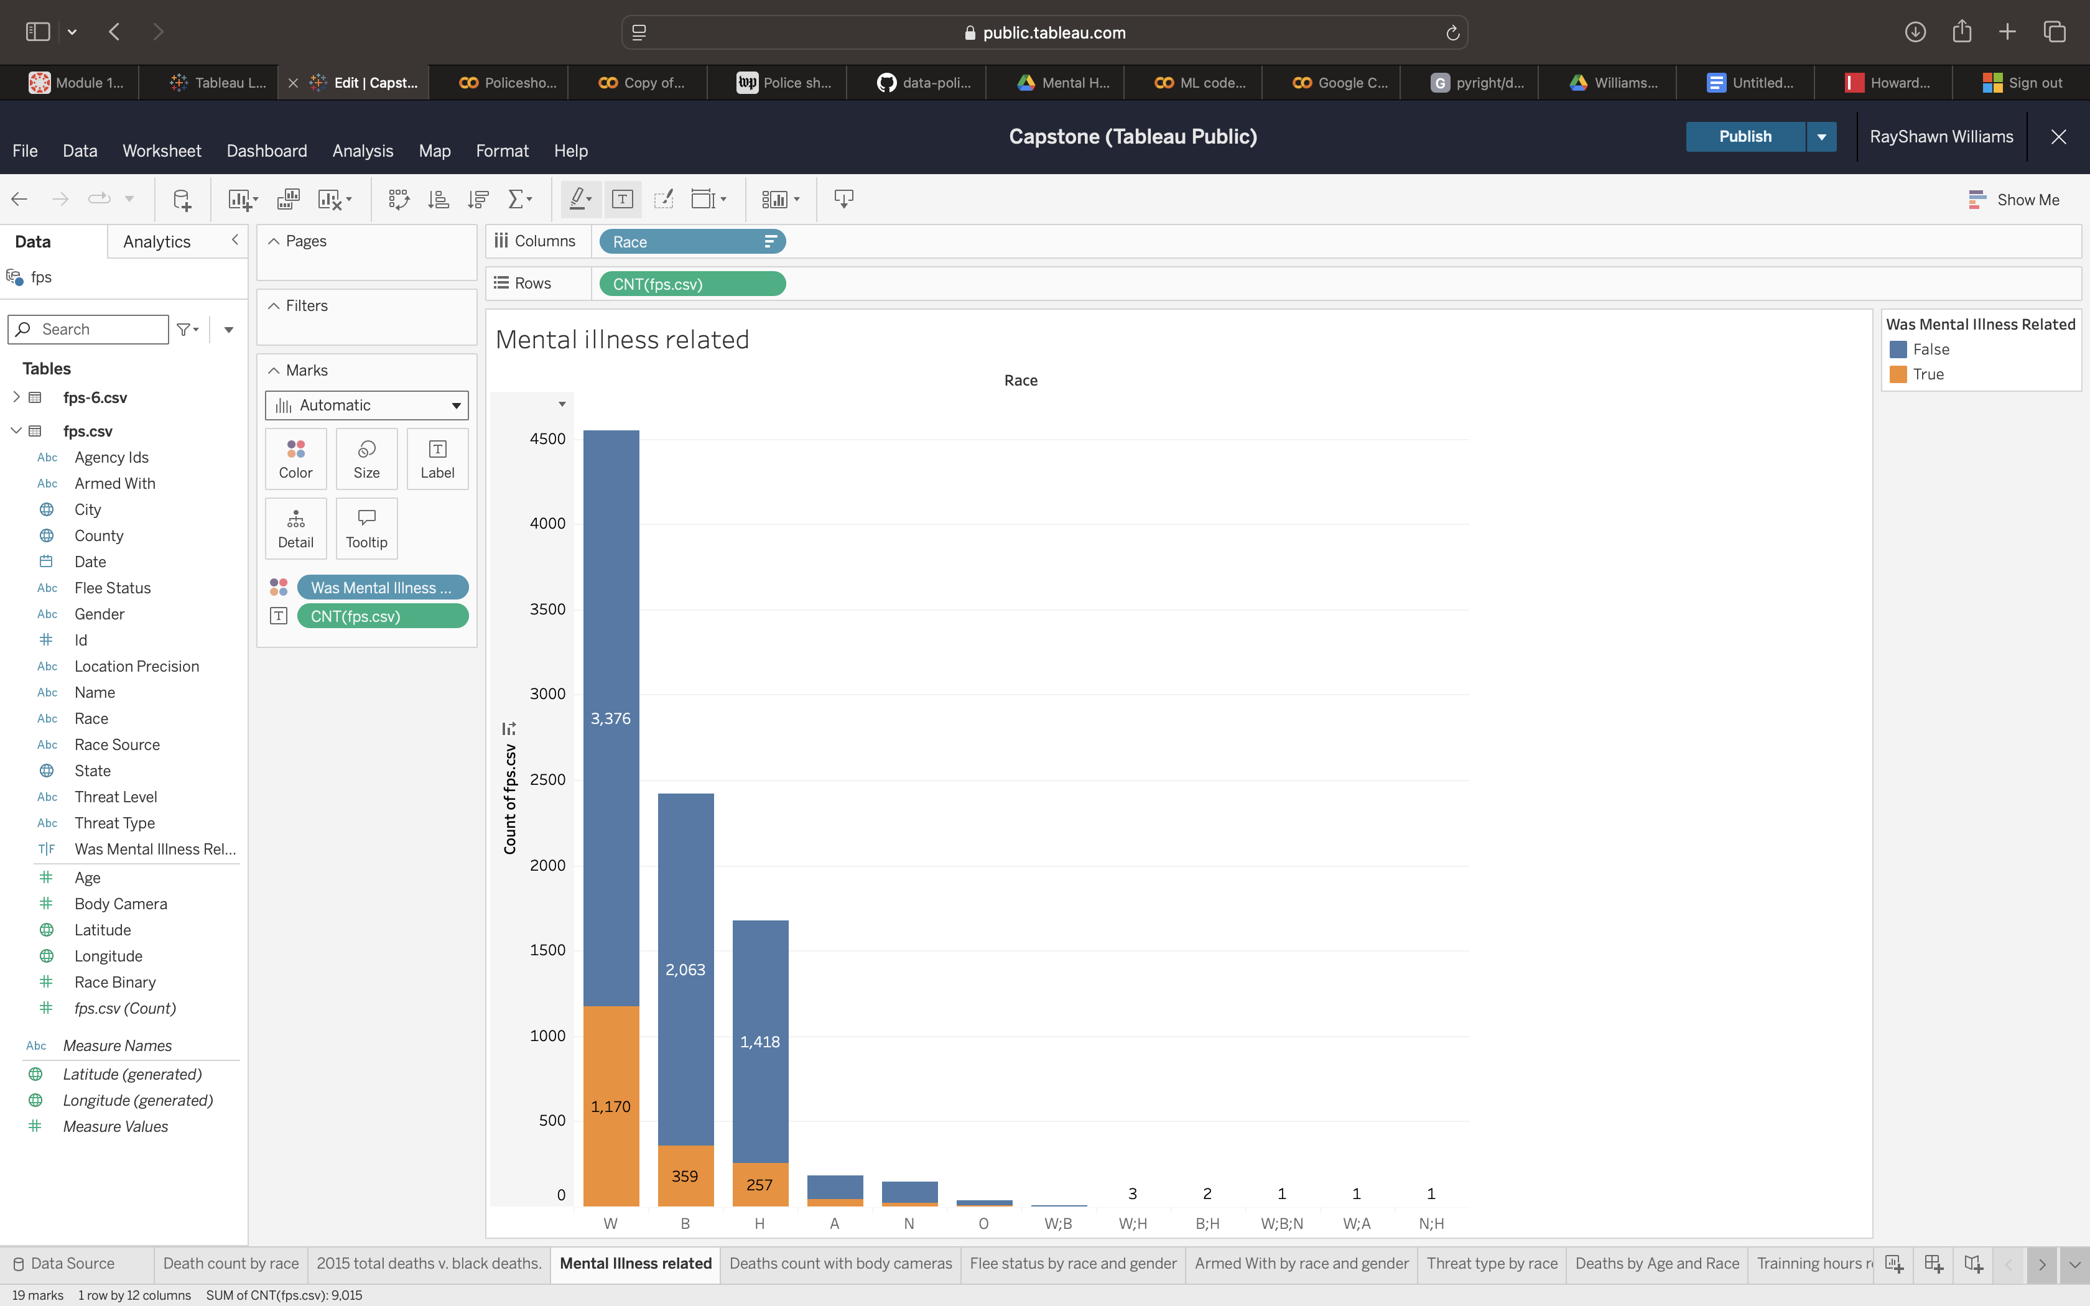

Slide 14
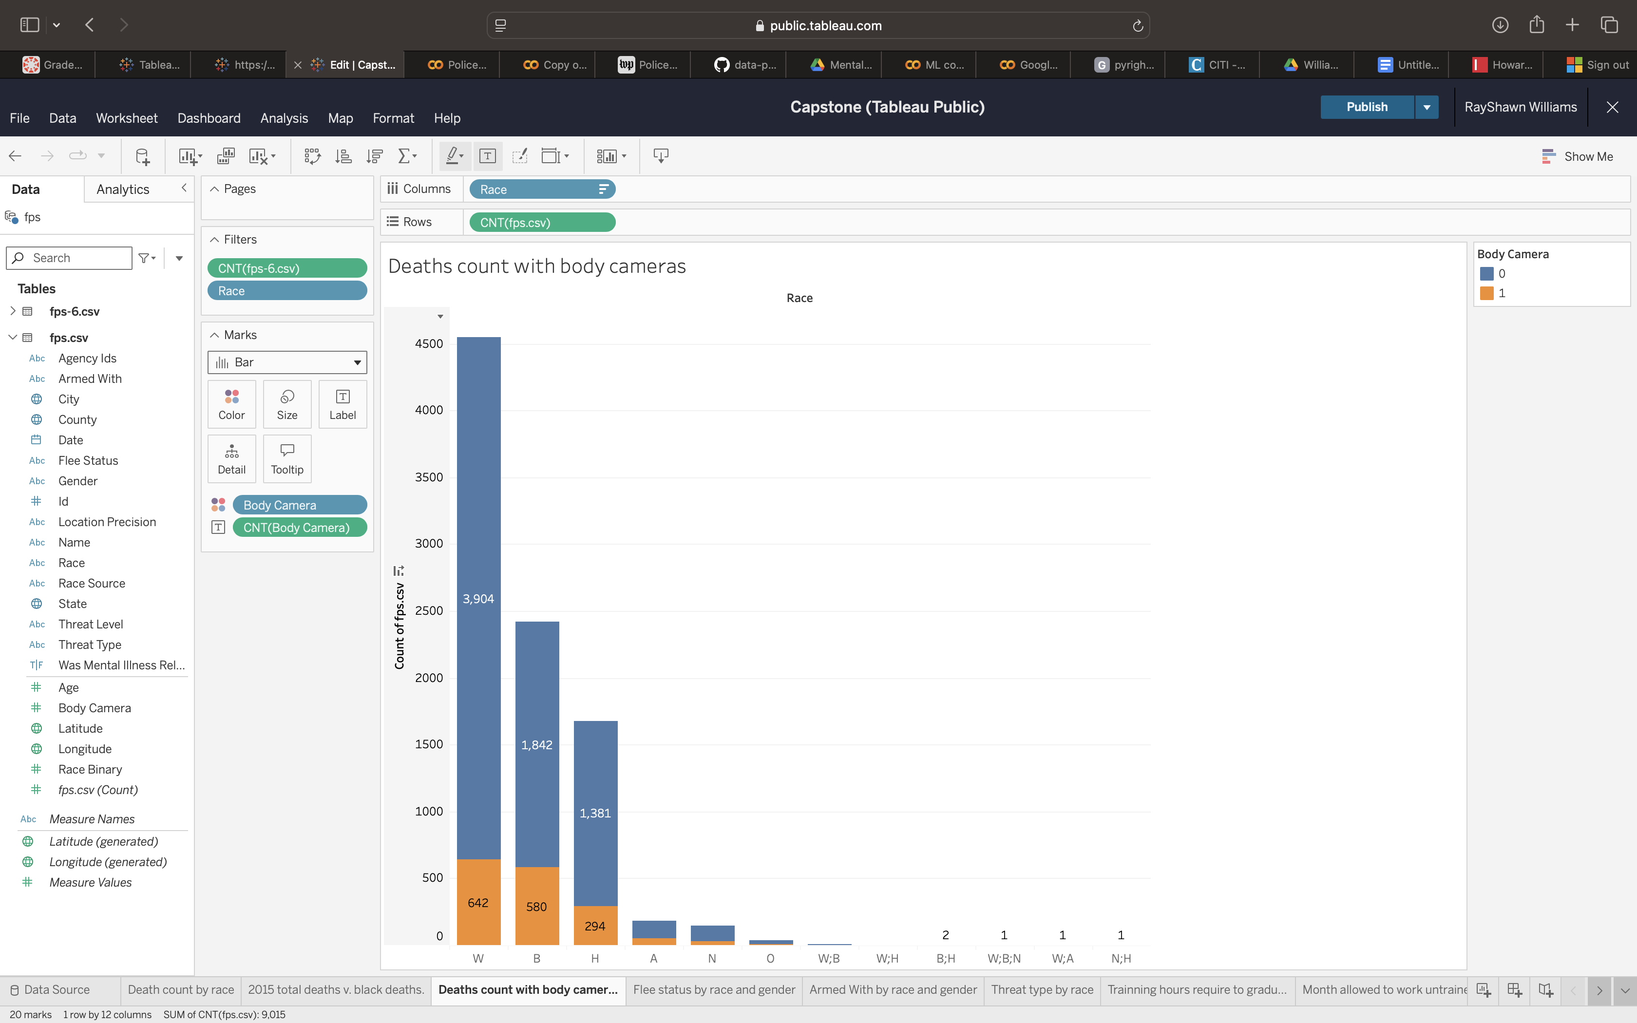

Slide 15
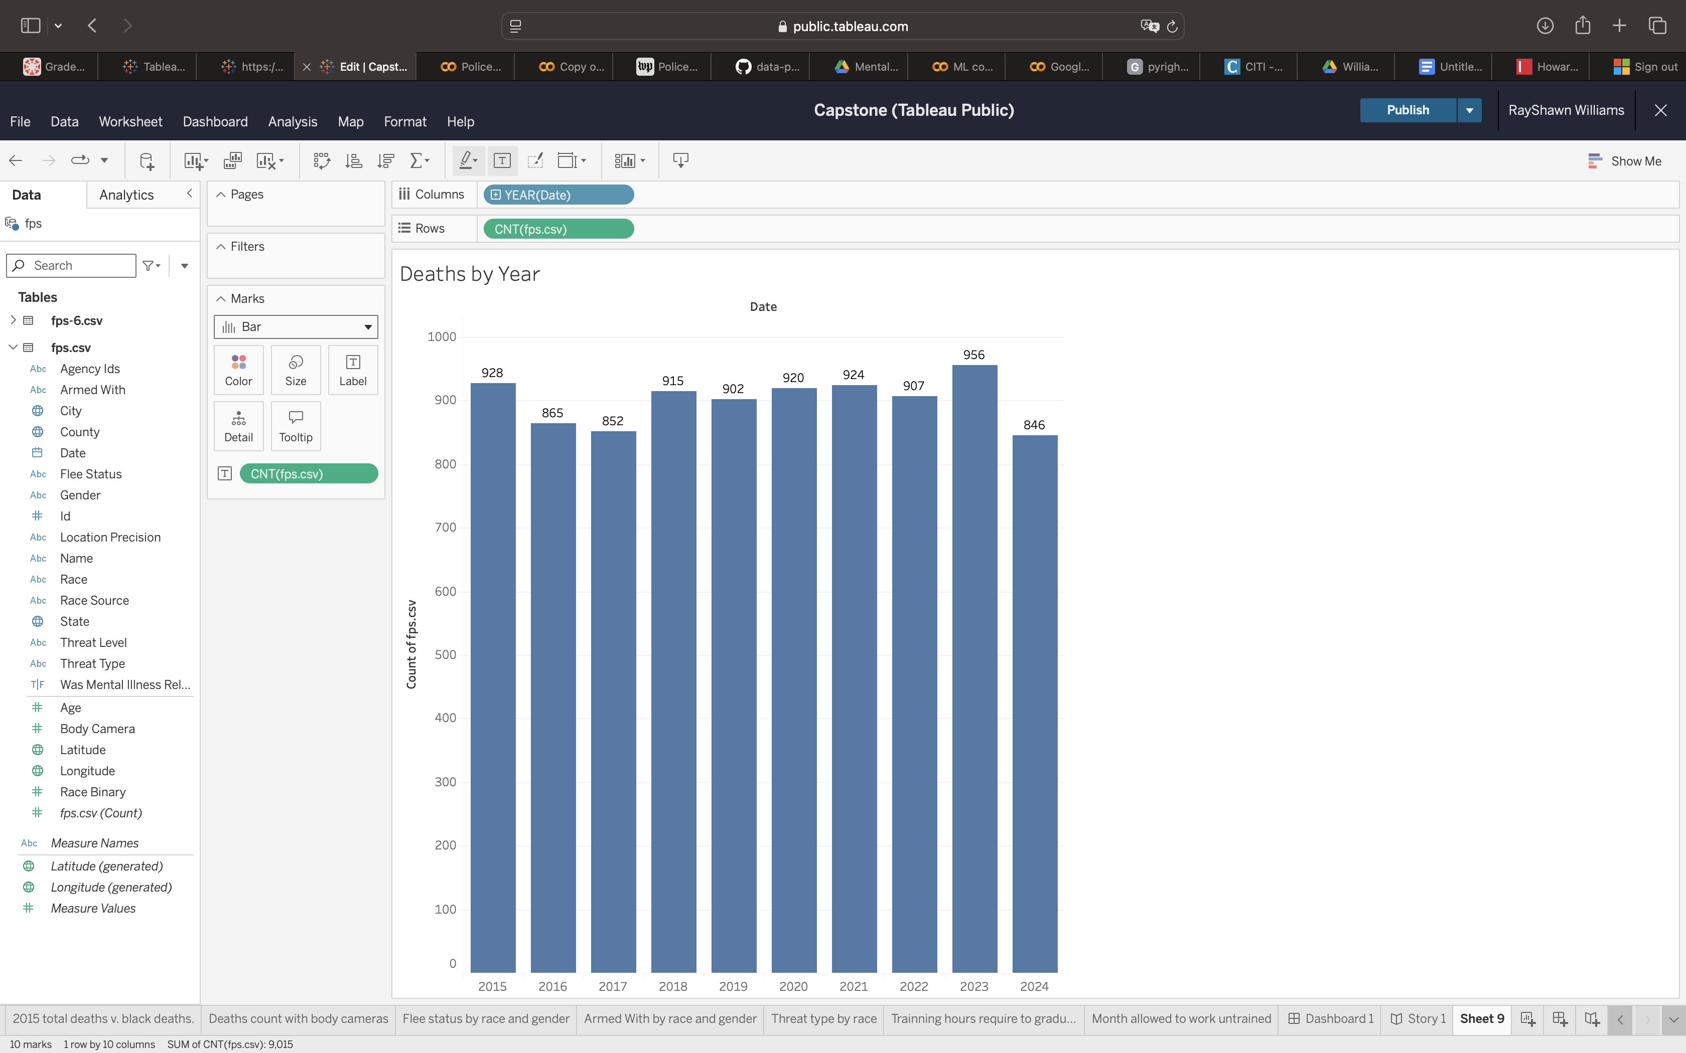

Slide 16
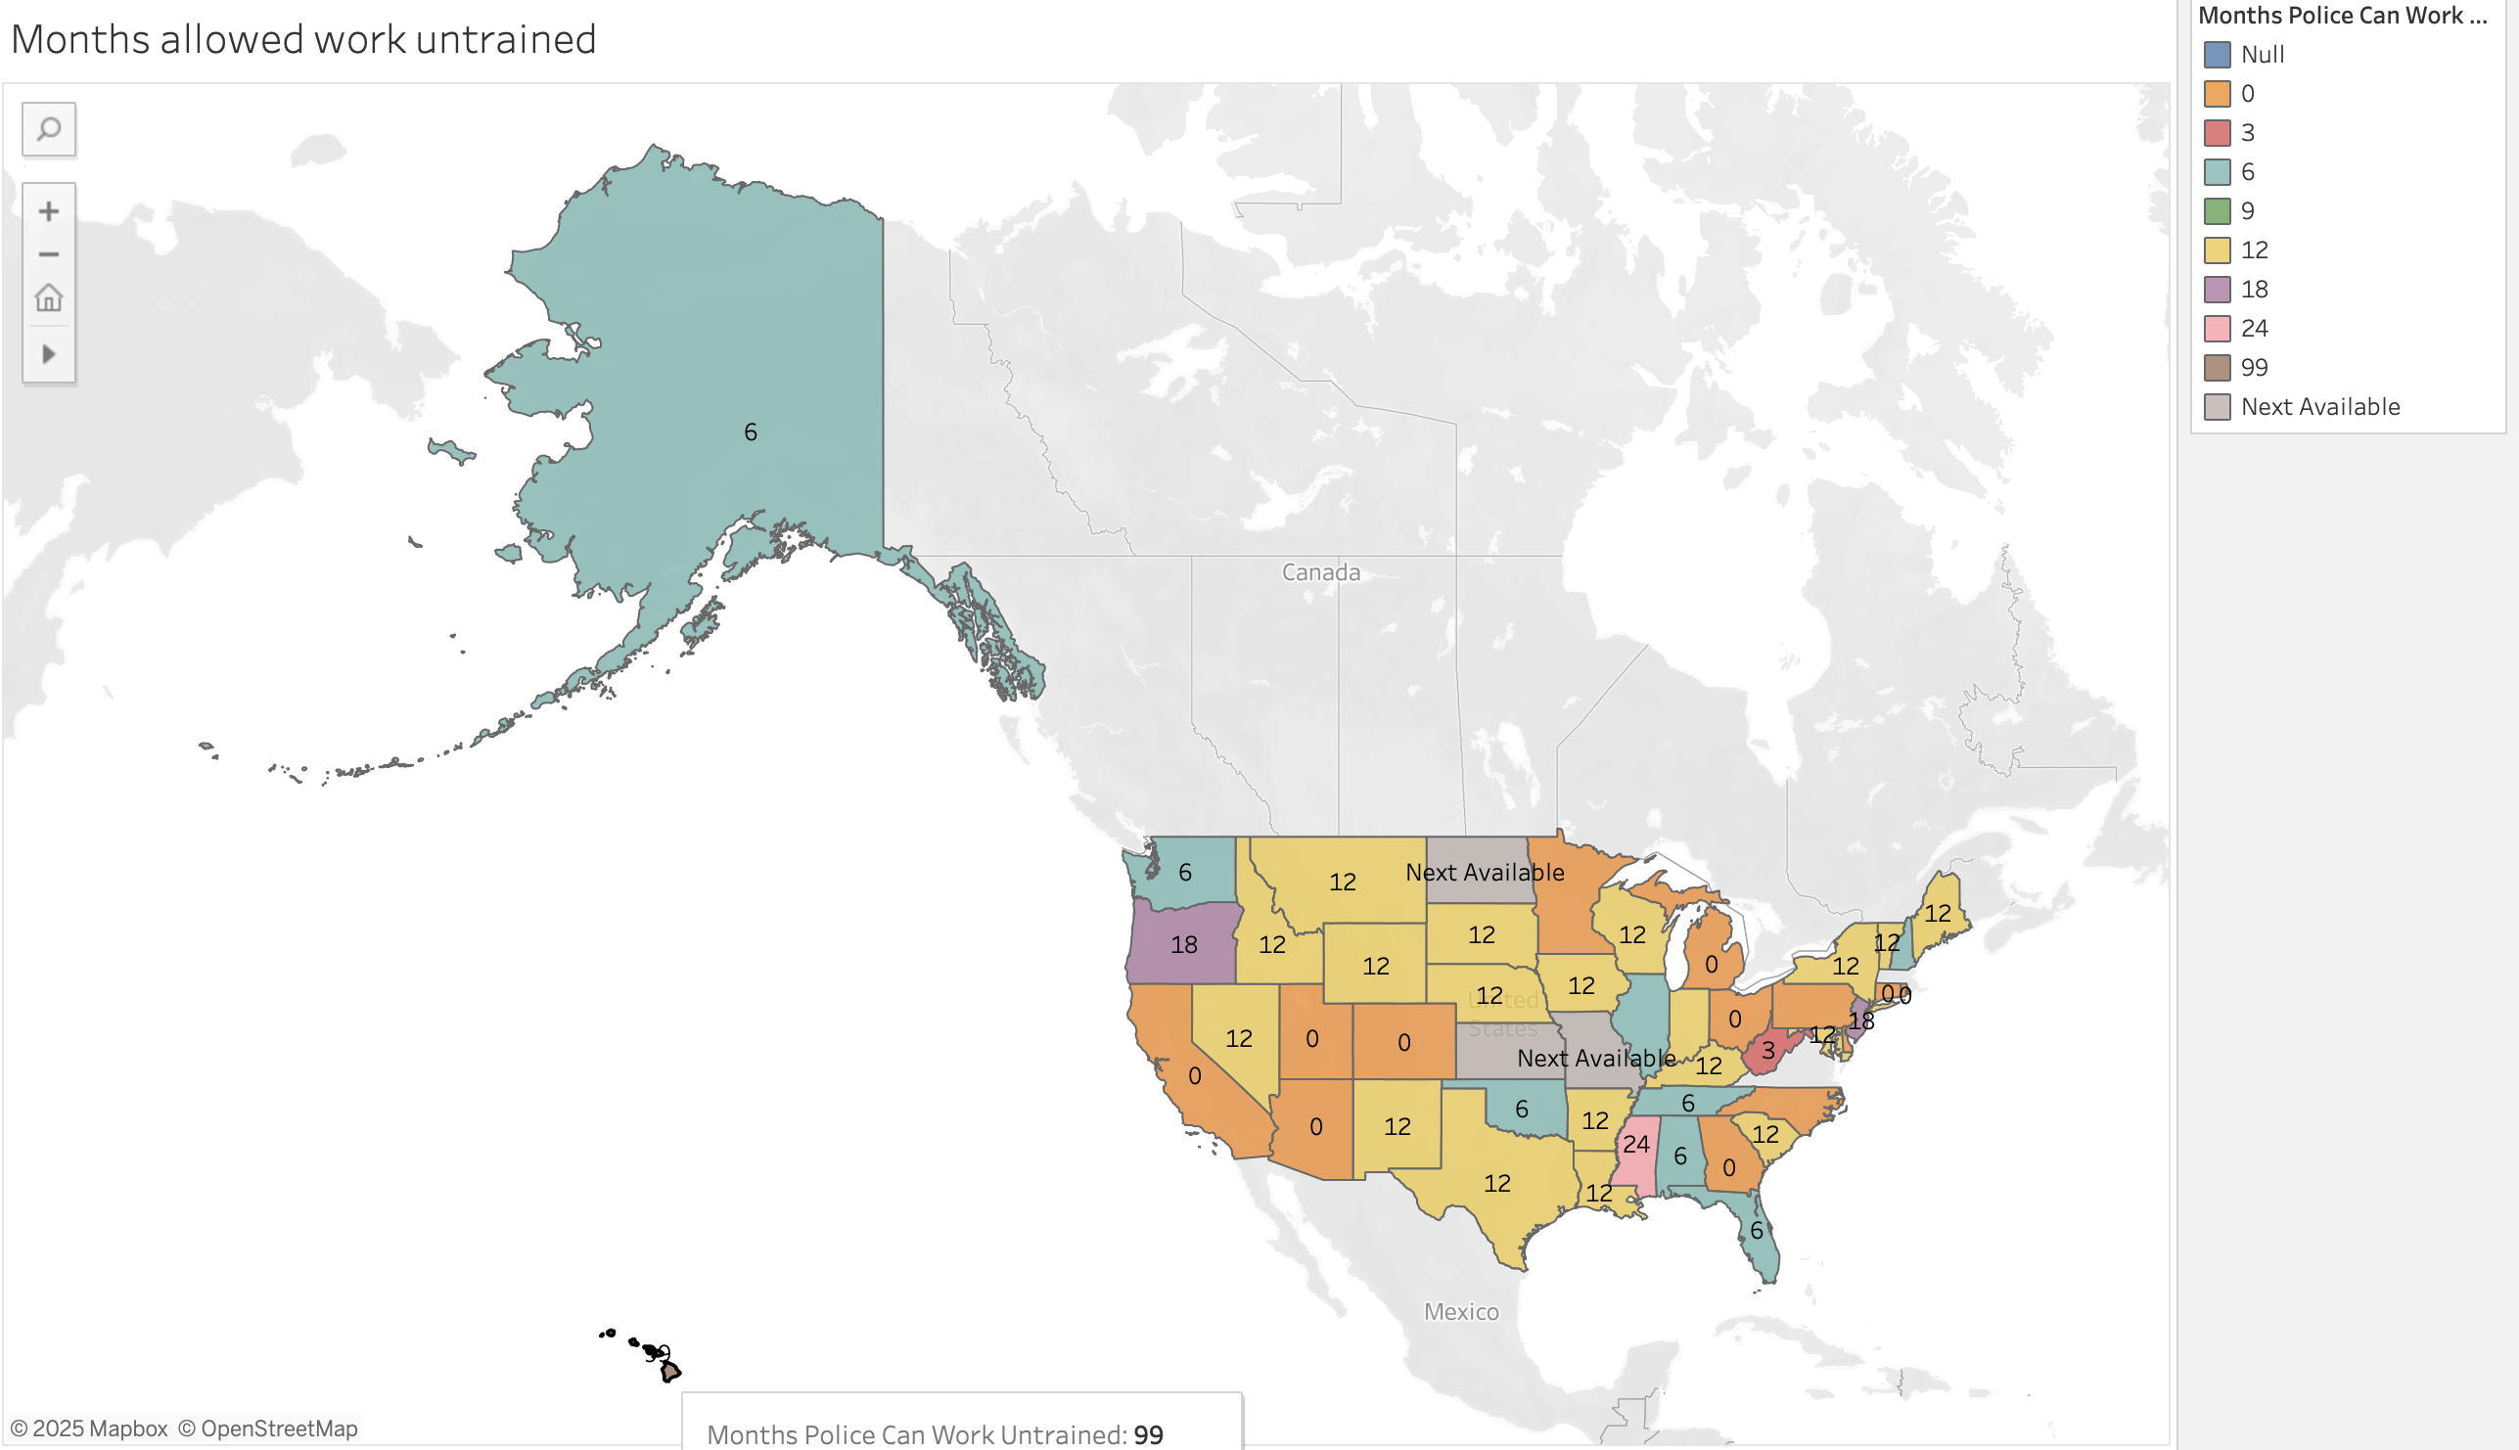
Months Without Training

Slide 17
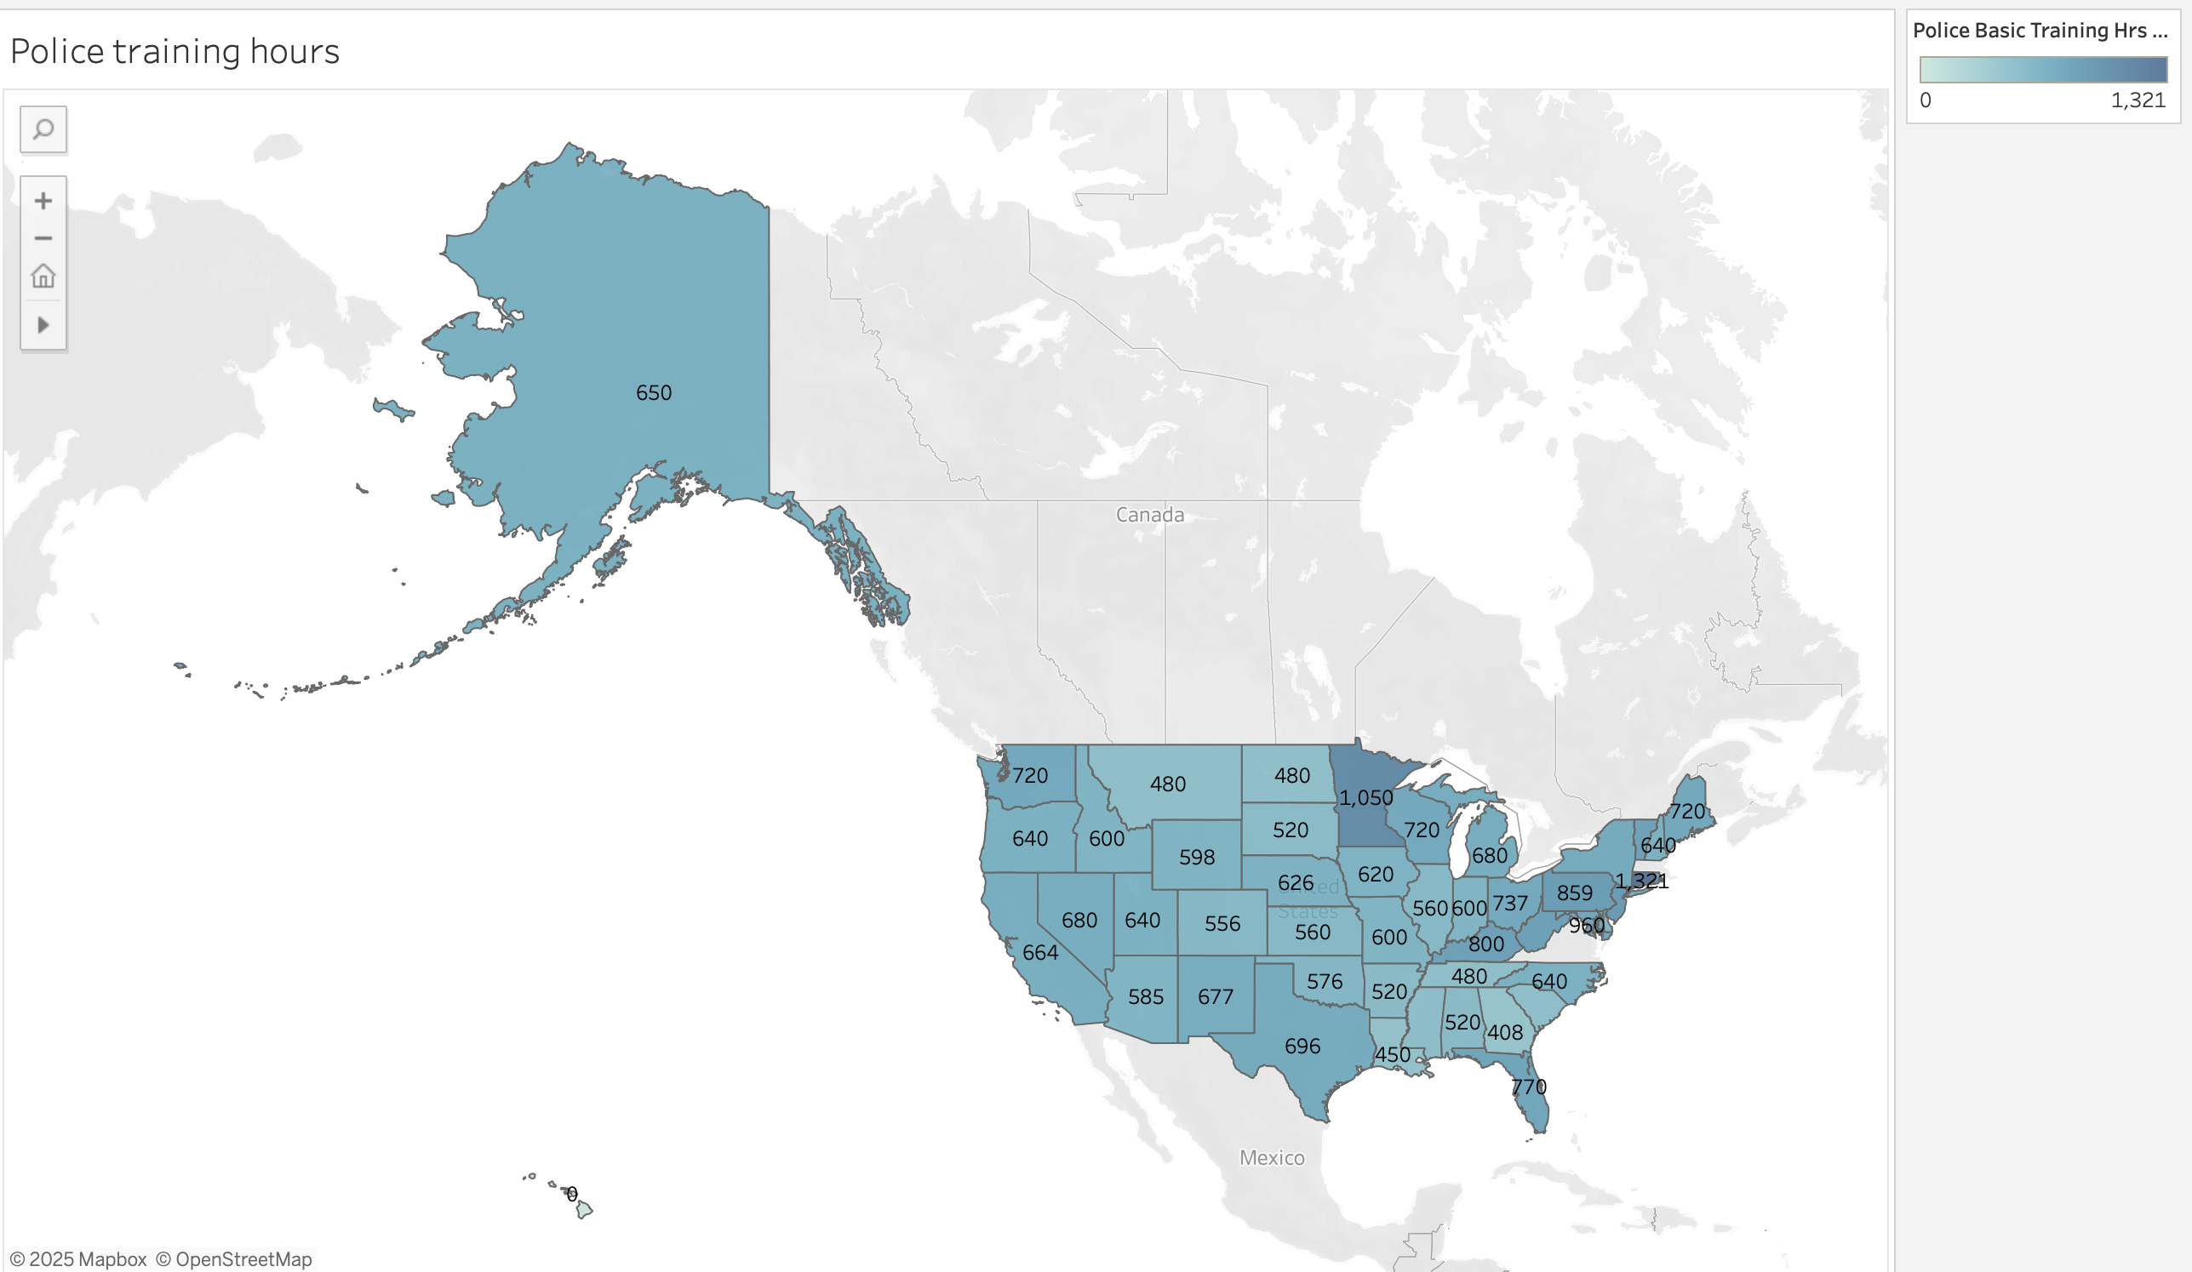
Required basic training

Slide 18
Data Cleaning
Drop
Categories with no correlation
Drop
Columns missing 15% or more of their data

Slide 19
Exploratory Data Analysis
Data Cleaning
Counts & Visuals
Variable creation

Slide 20
Methodologies
Hyperparameter
AUC-ROC
XG Boost
Feature Engineering

Slide 21
Feature Engineering
Separate numeric and categoric features
Imputer and encoder
Pipeline, transformer and preprocessor
Create subsets target and features
Create binary and numeric variables

Slide 22
Machine Learning Models
XGBoost
KNN
Random Forest
Decision Tree
Gradient Boost
Ada Boost

Slide 23
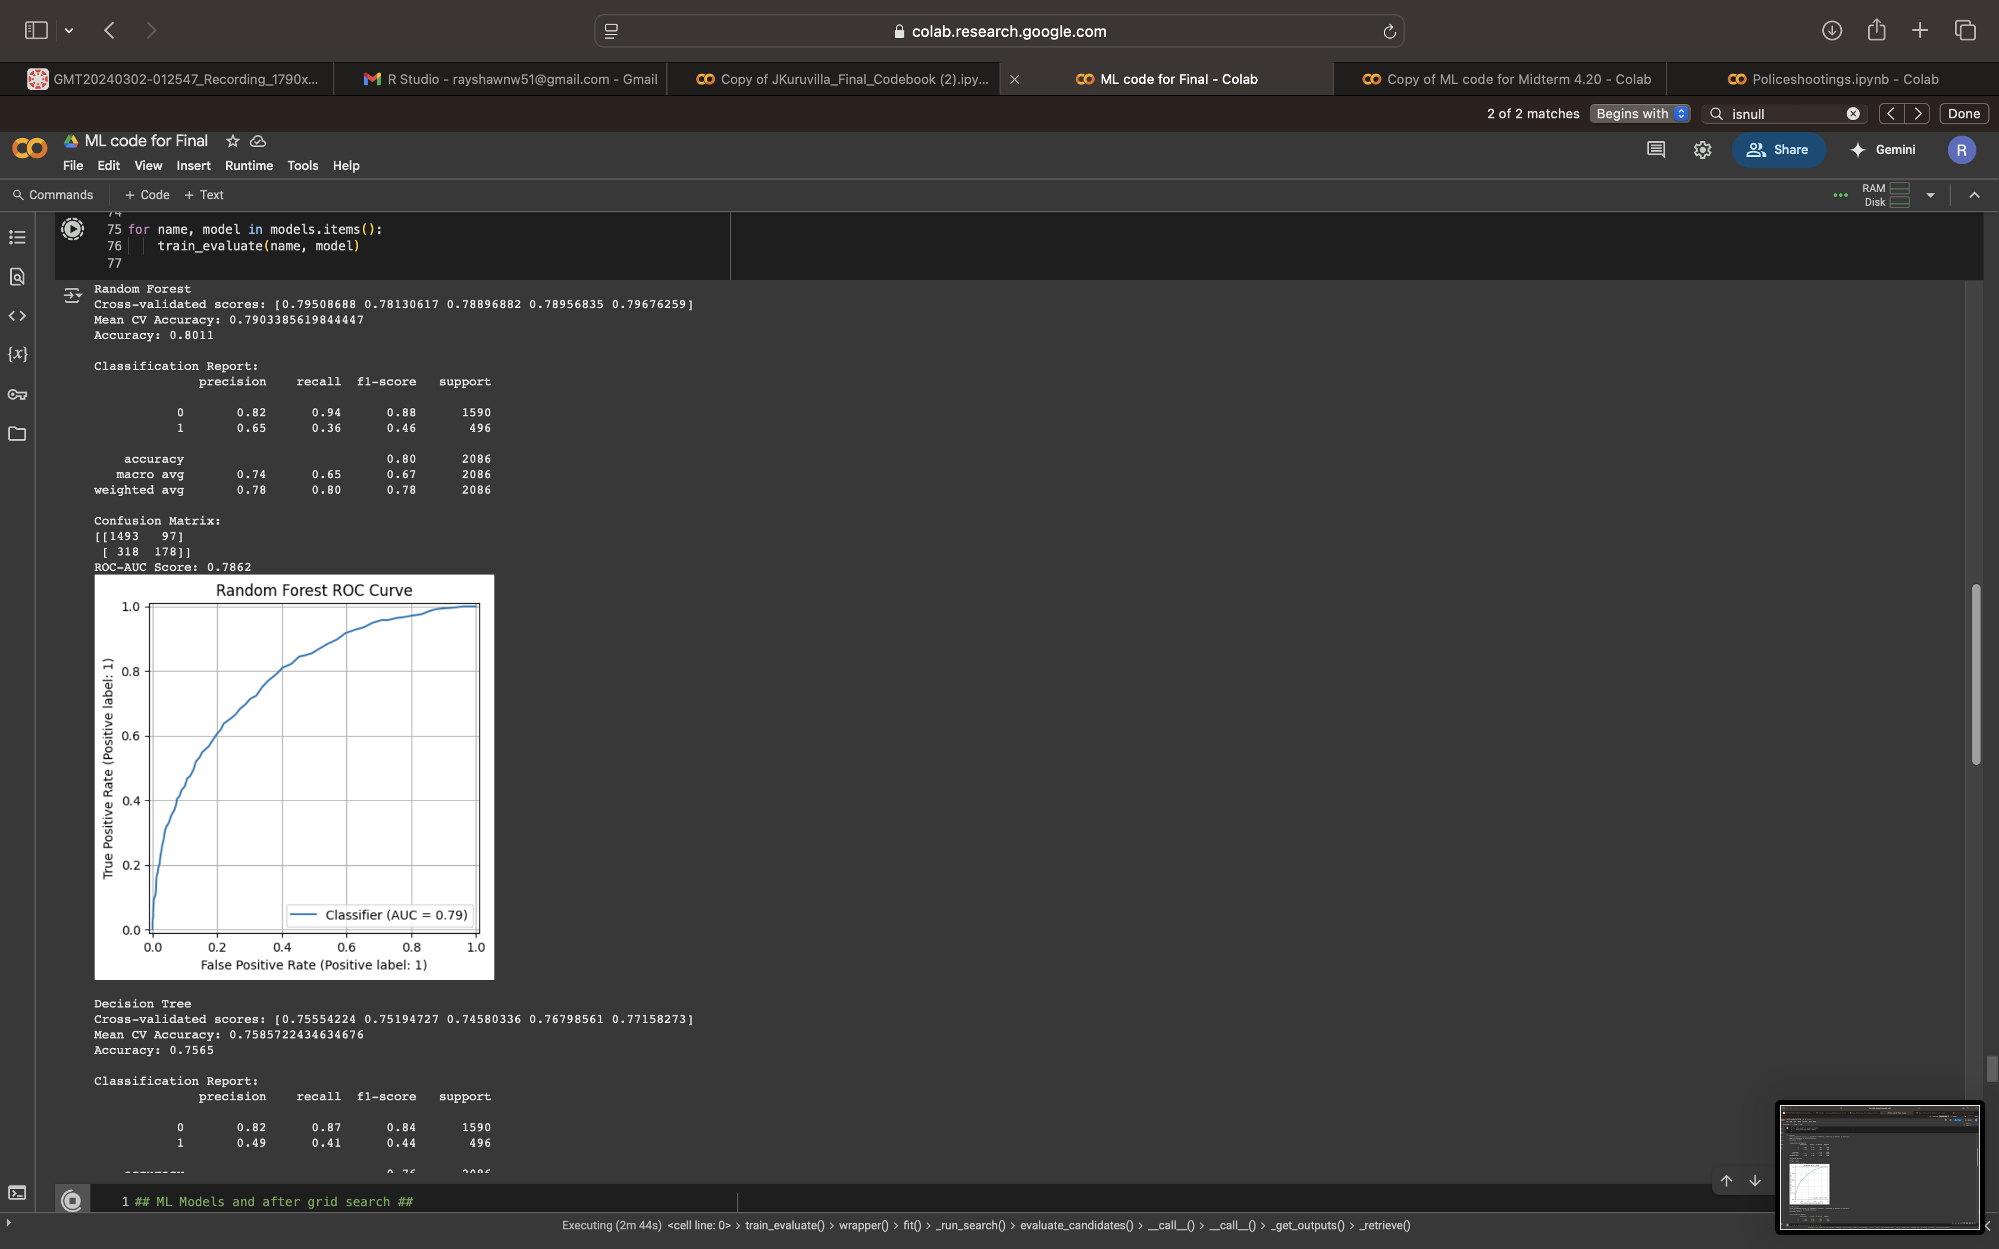
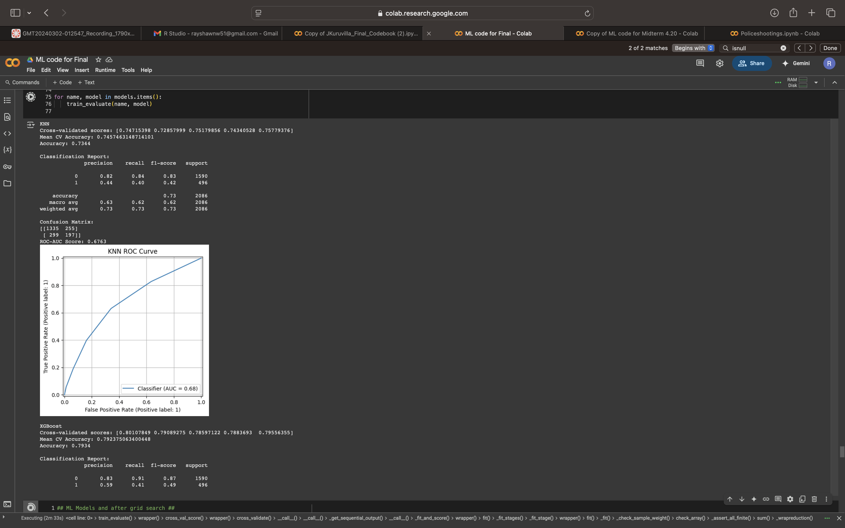
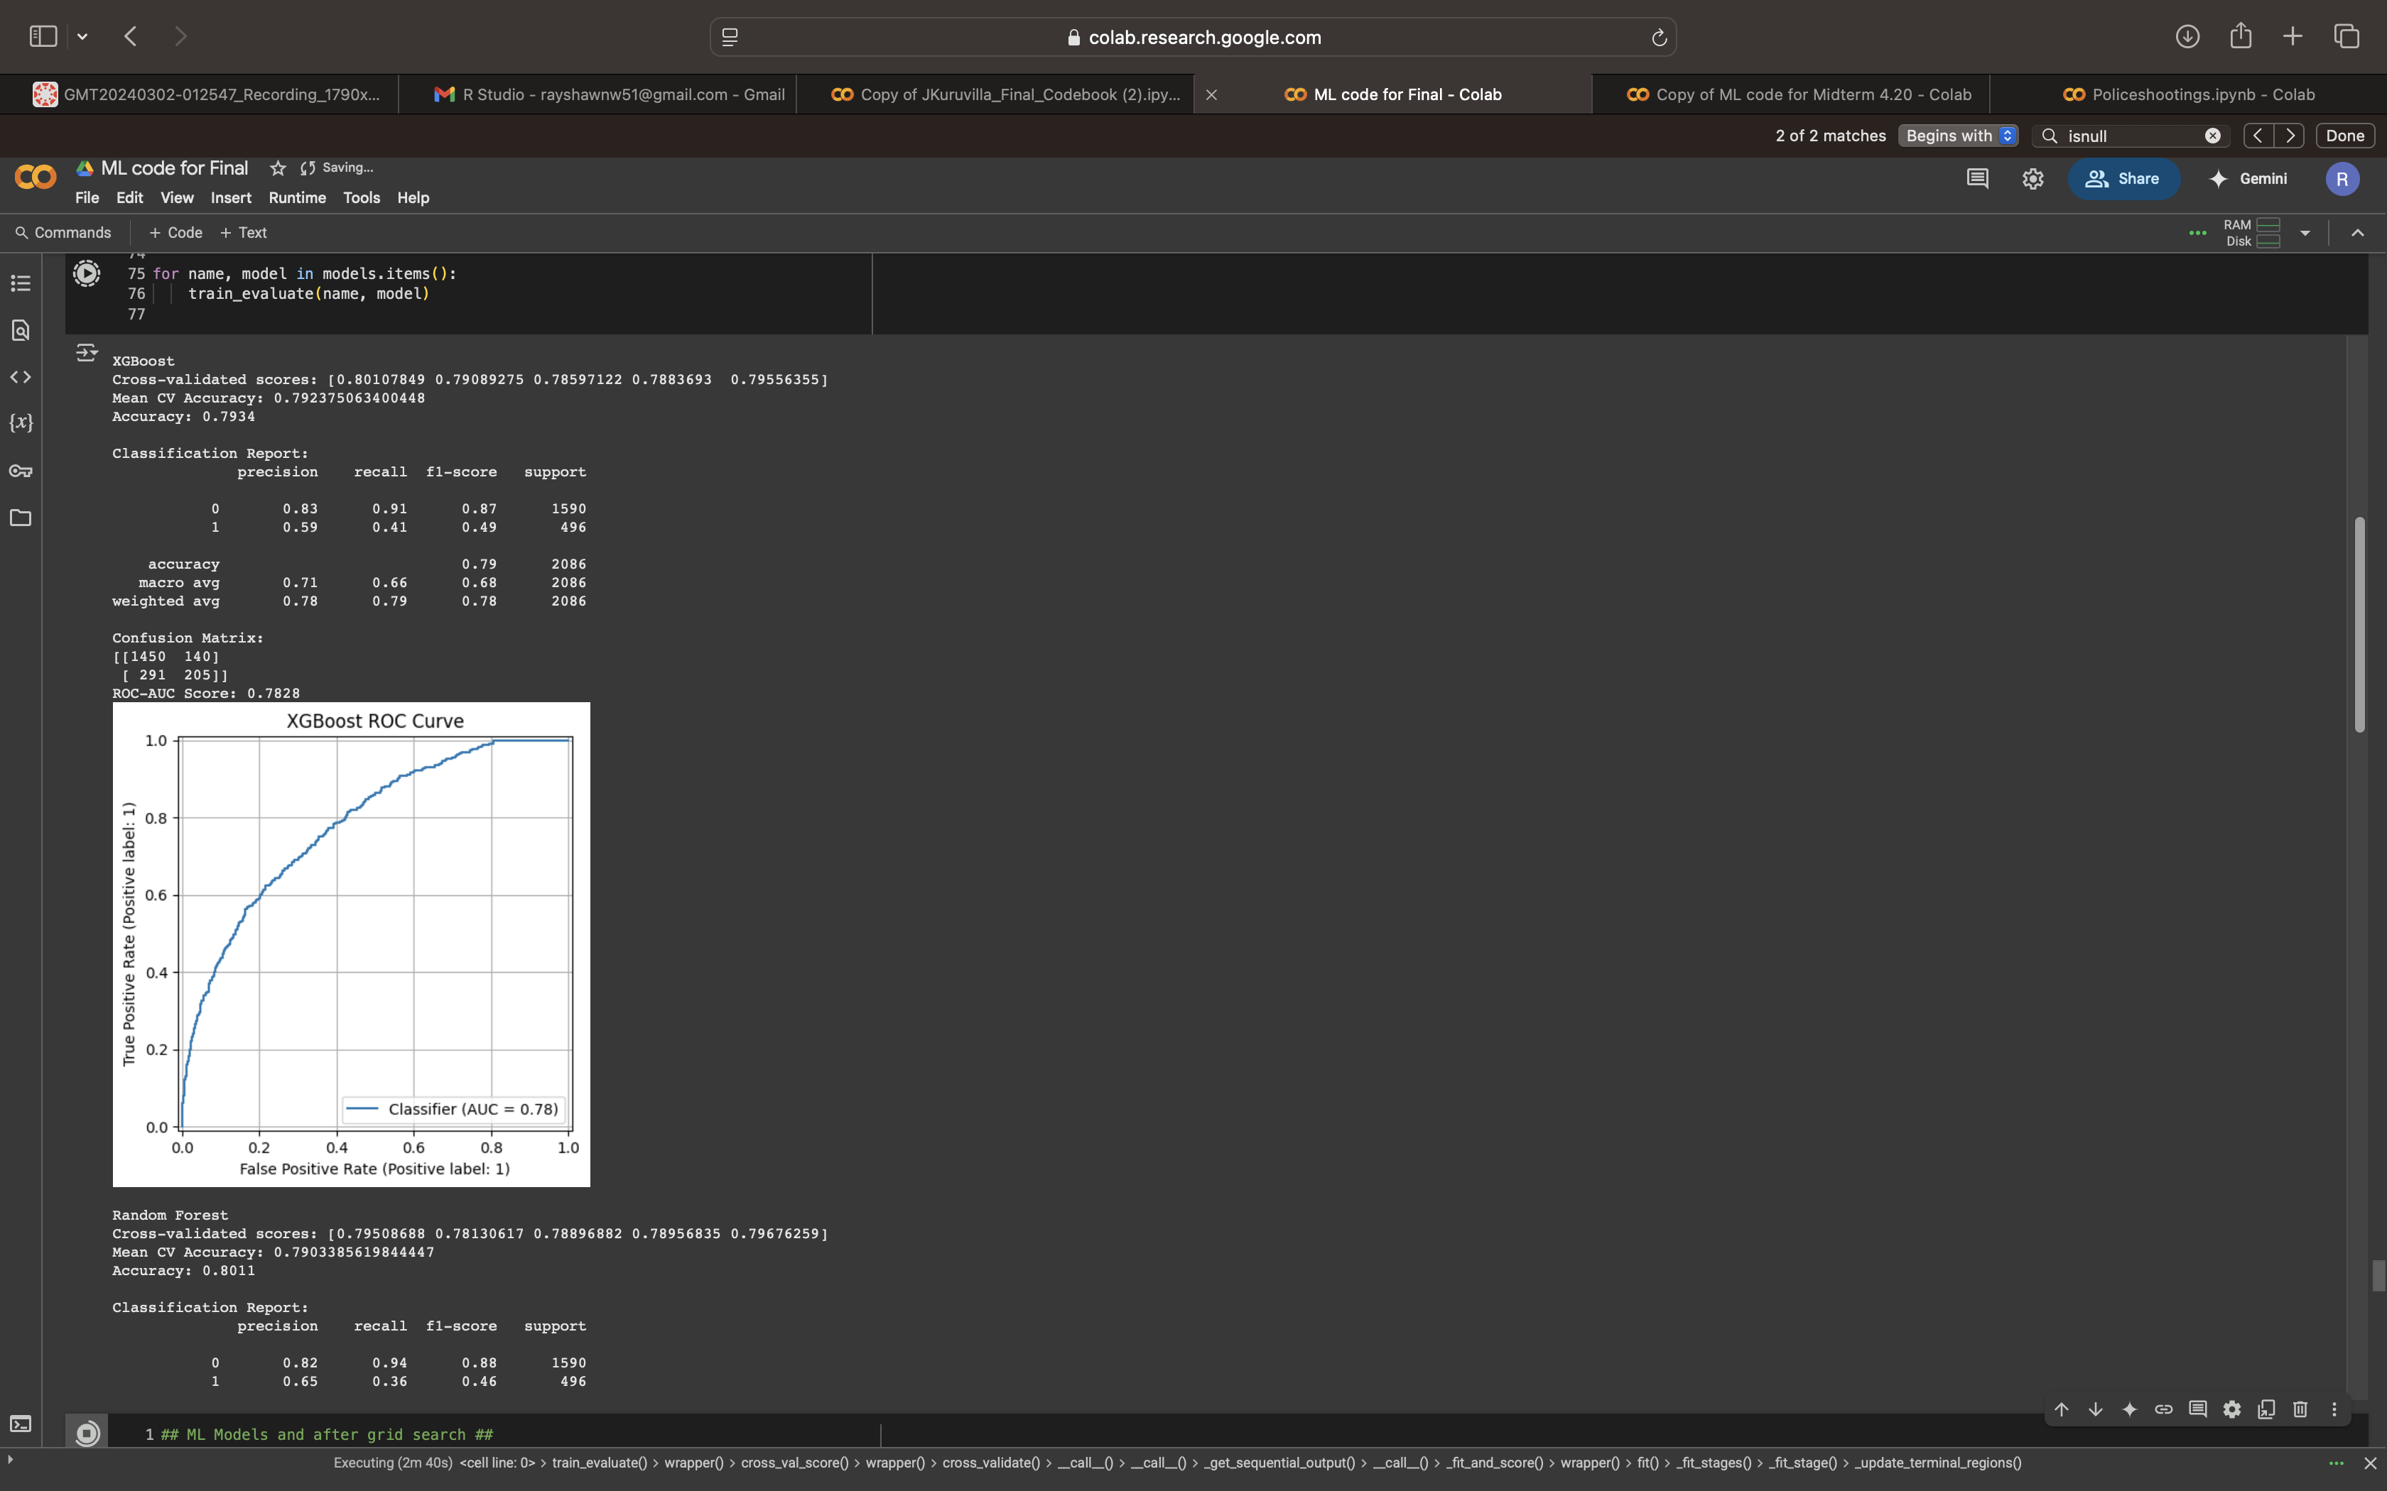
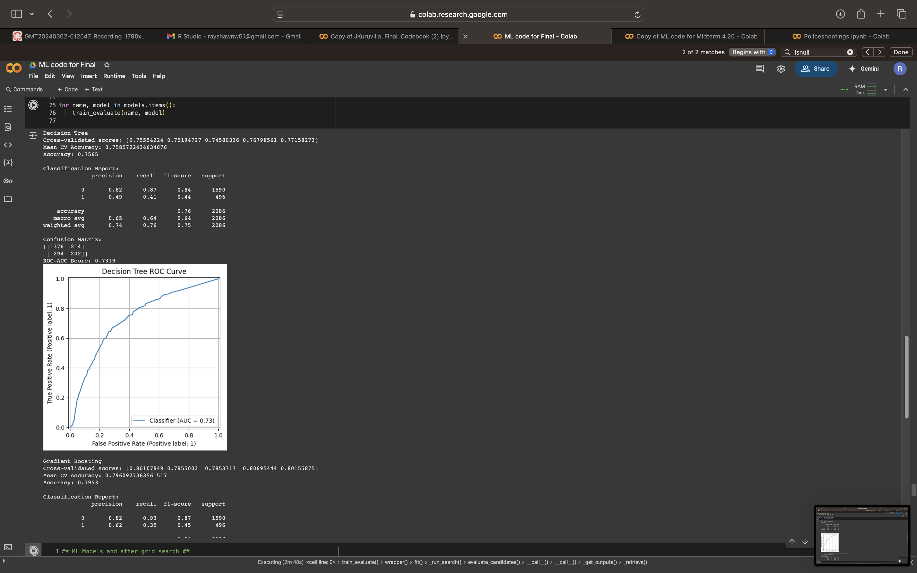
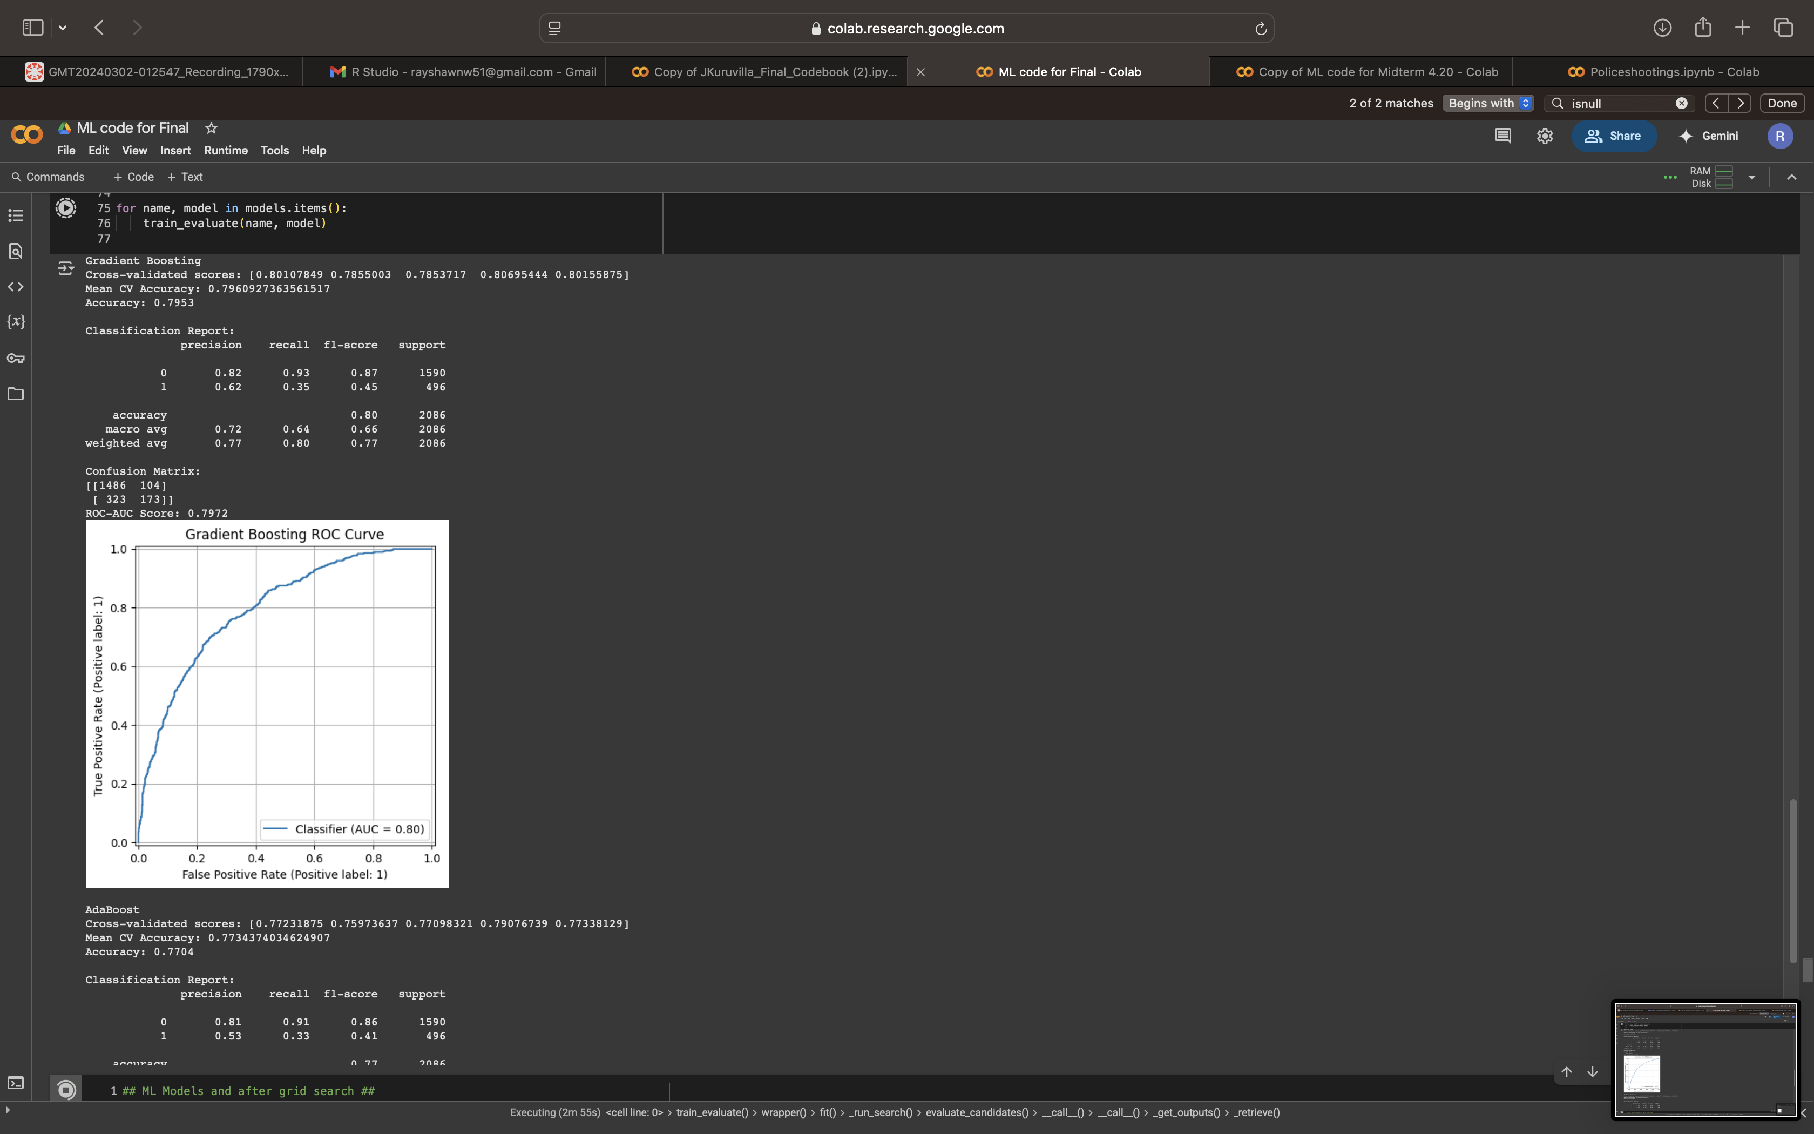
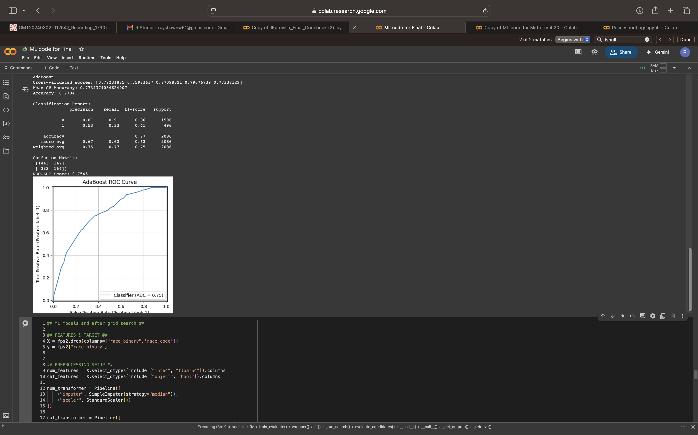
Before Grid search

Slide 24
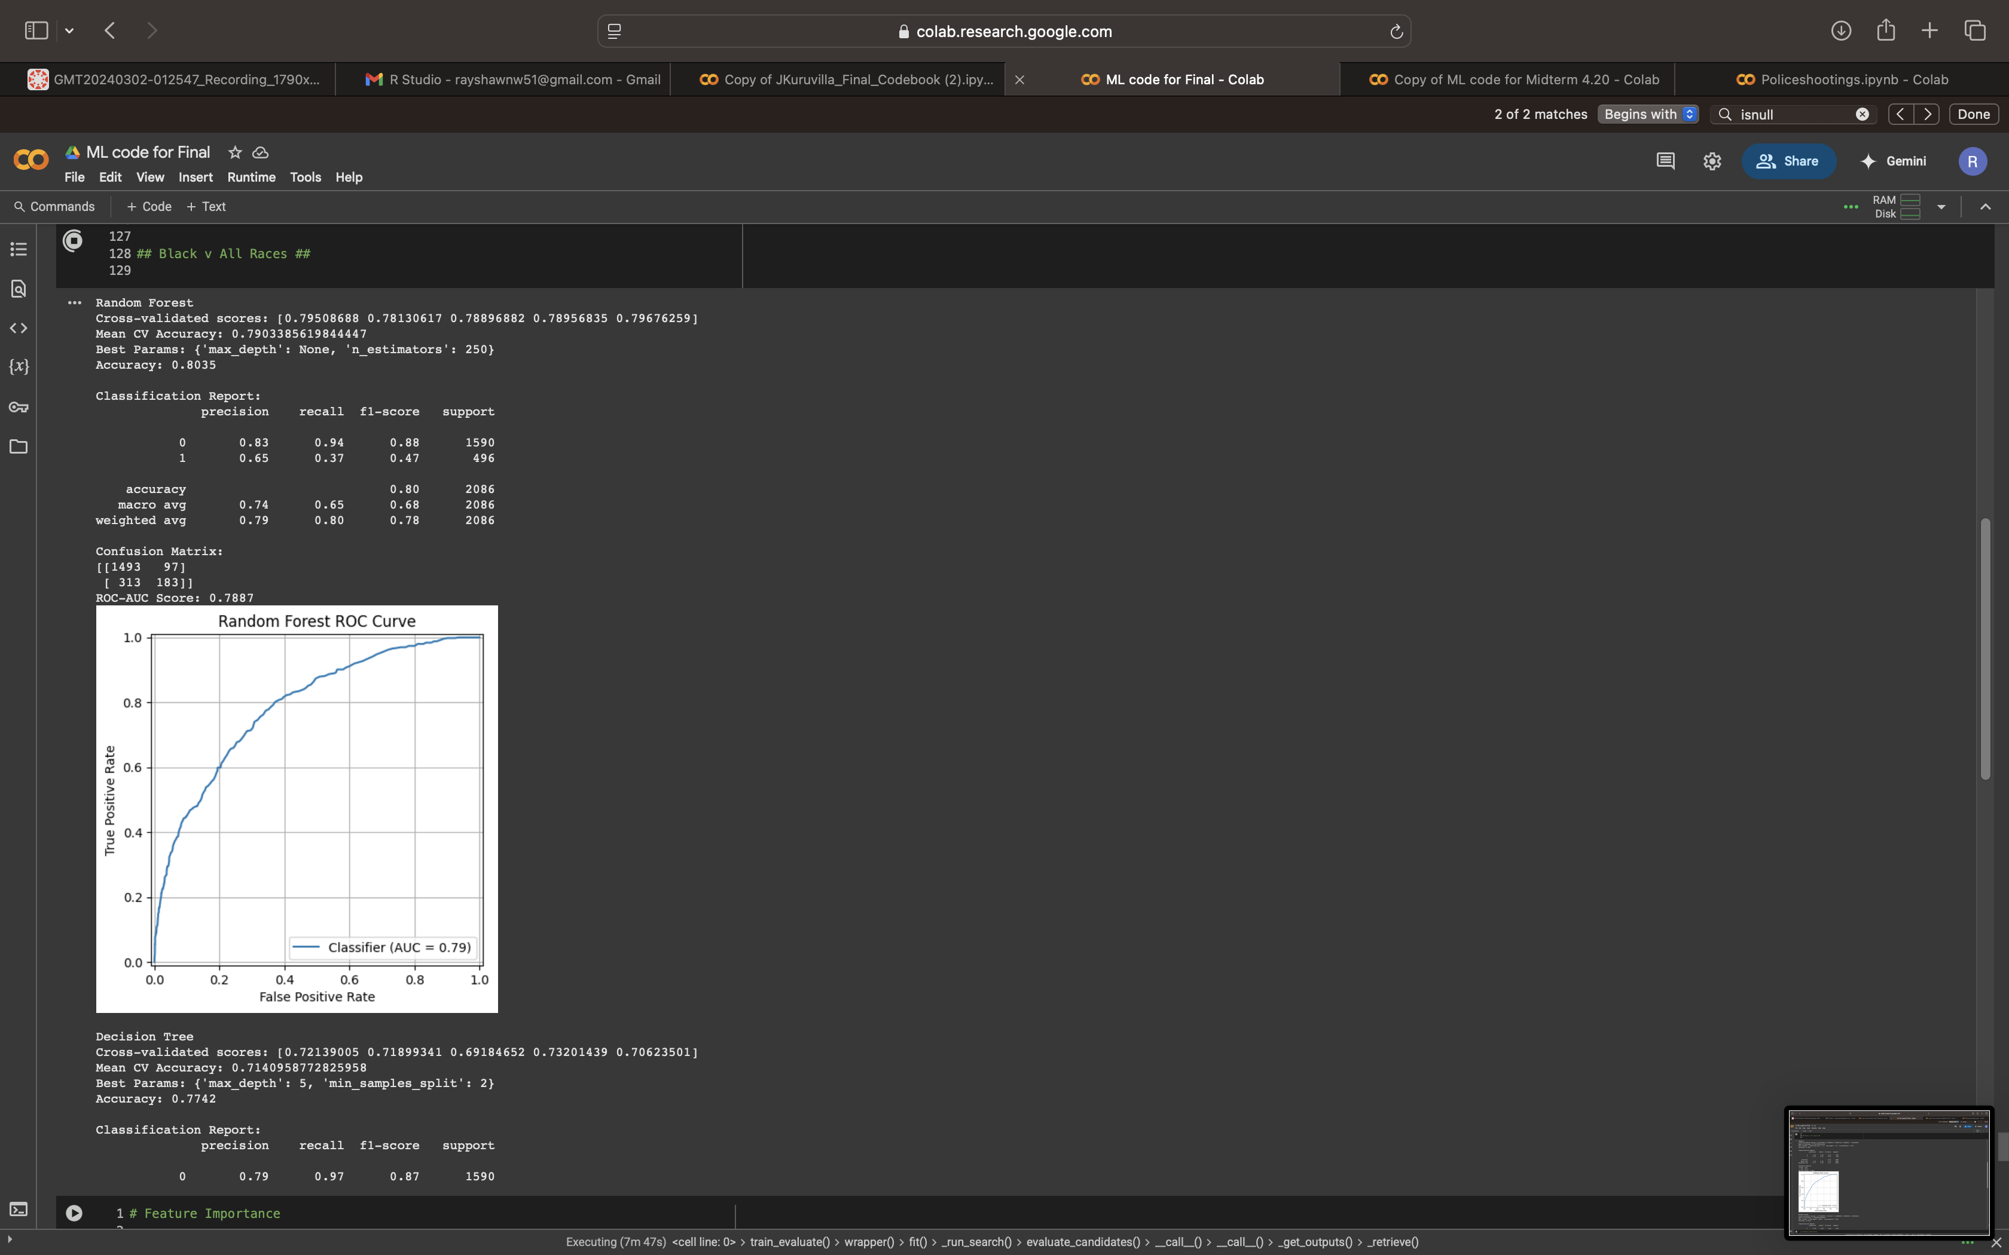
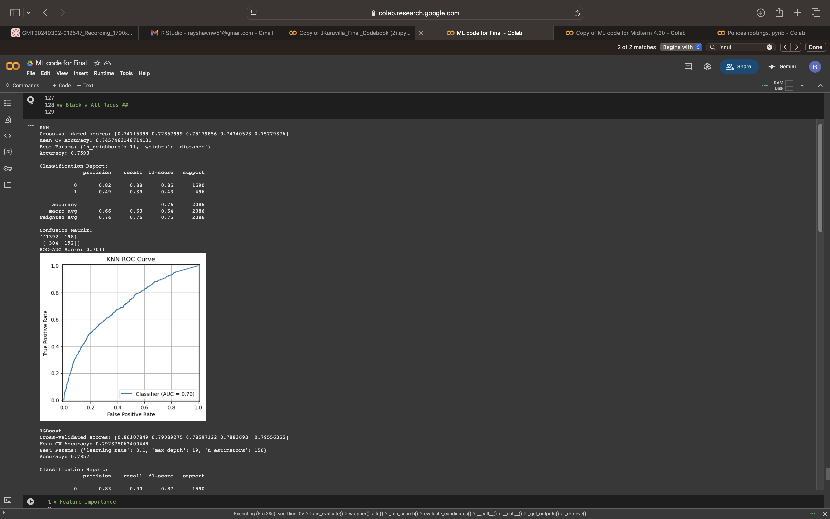
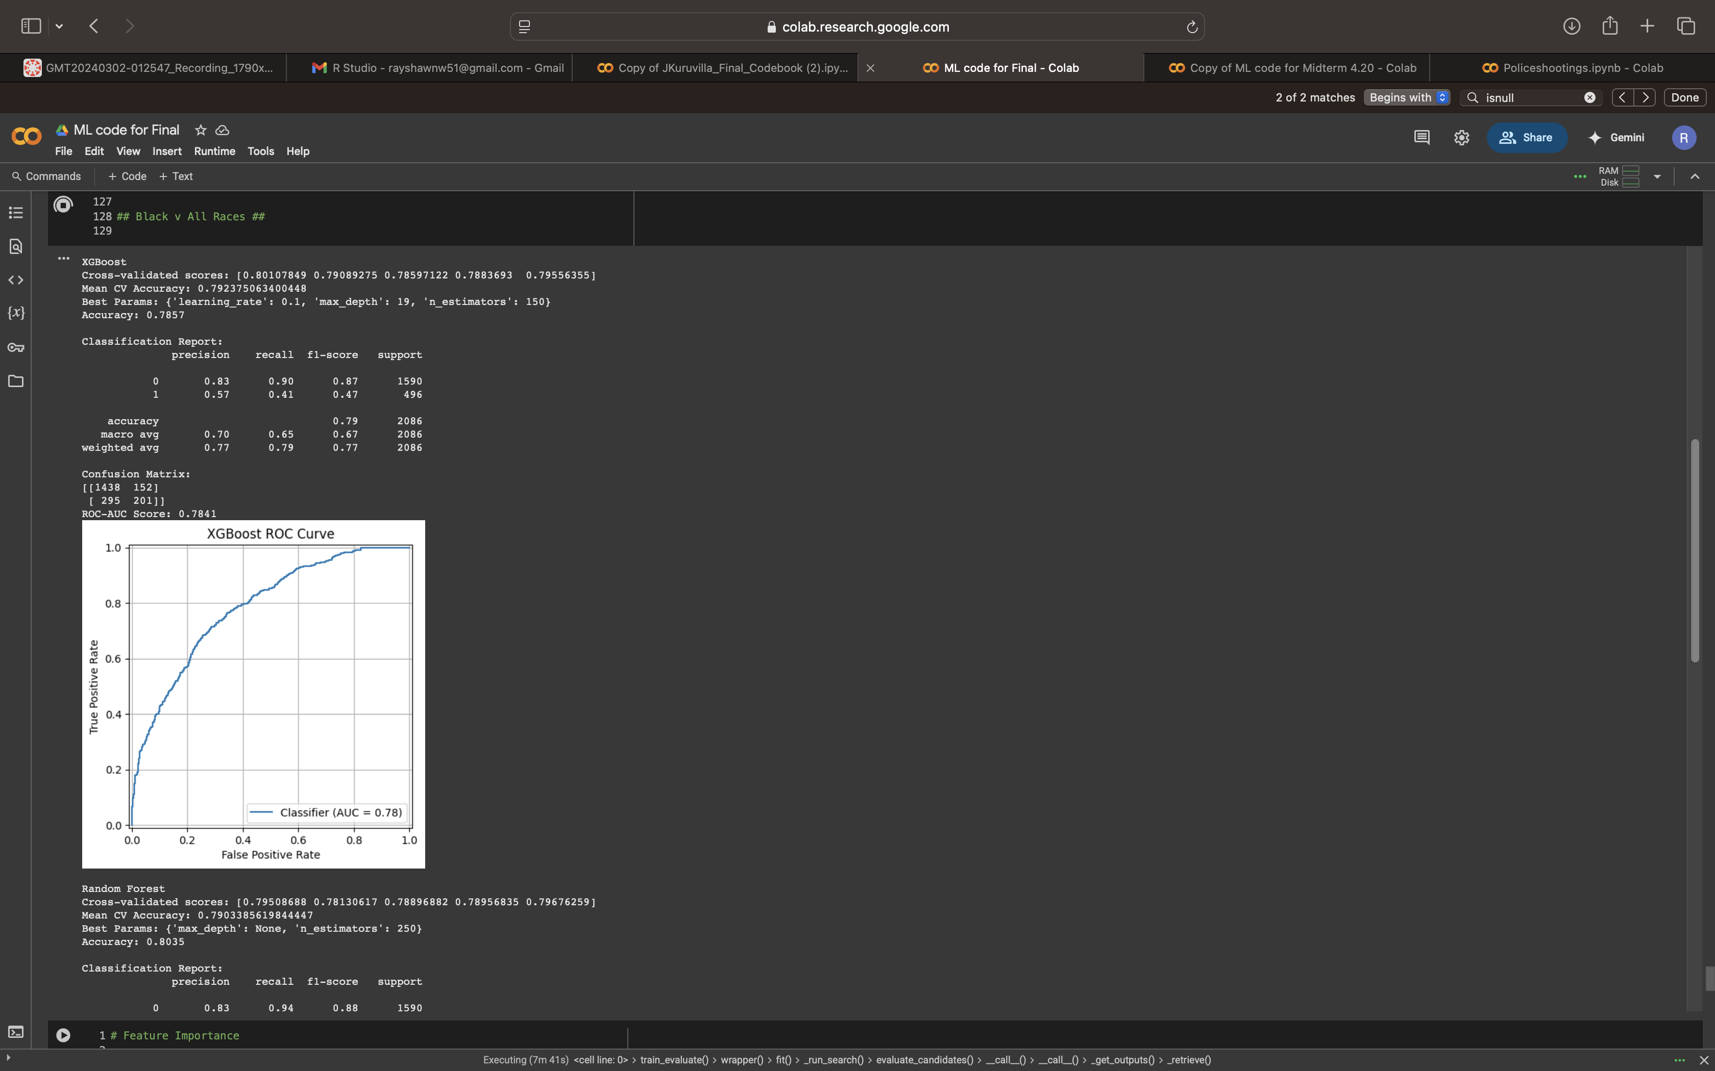
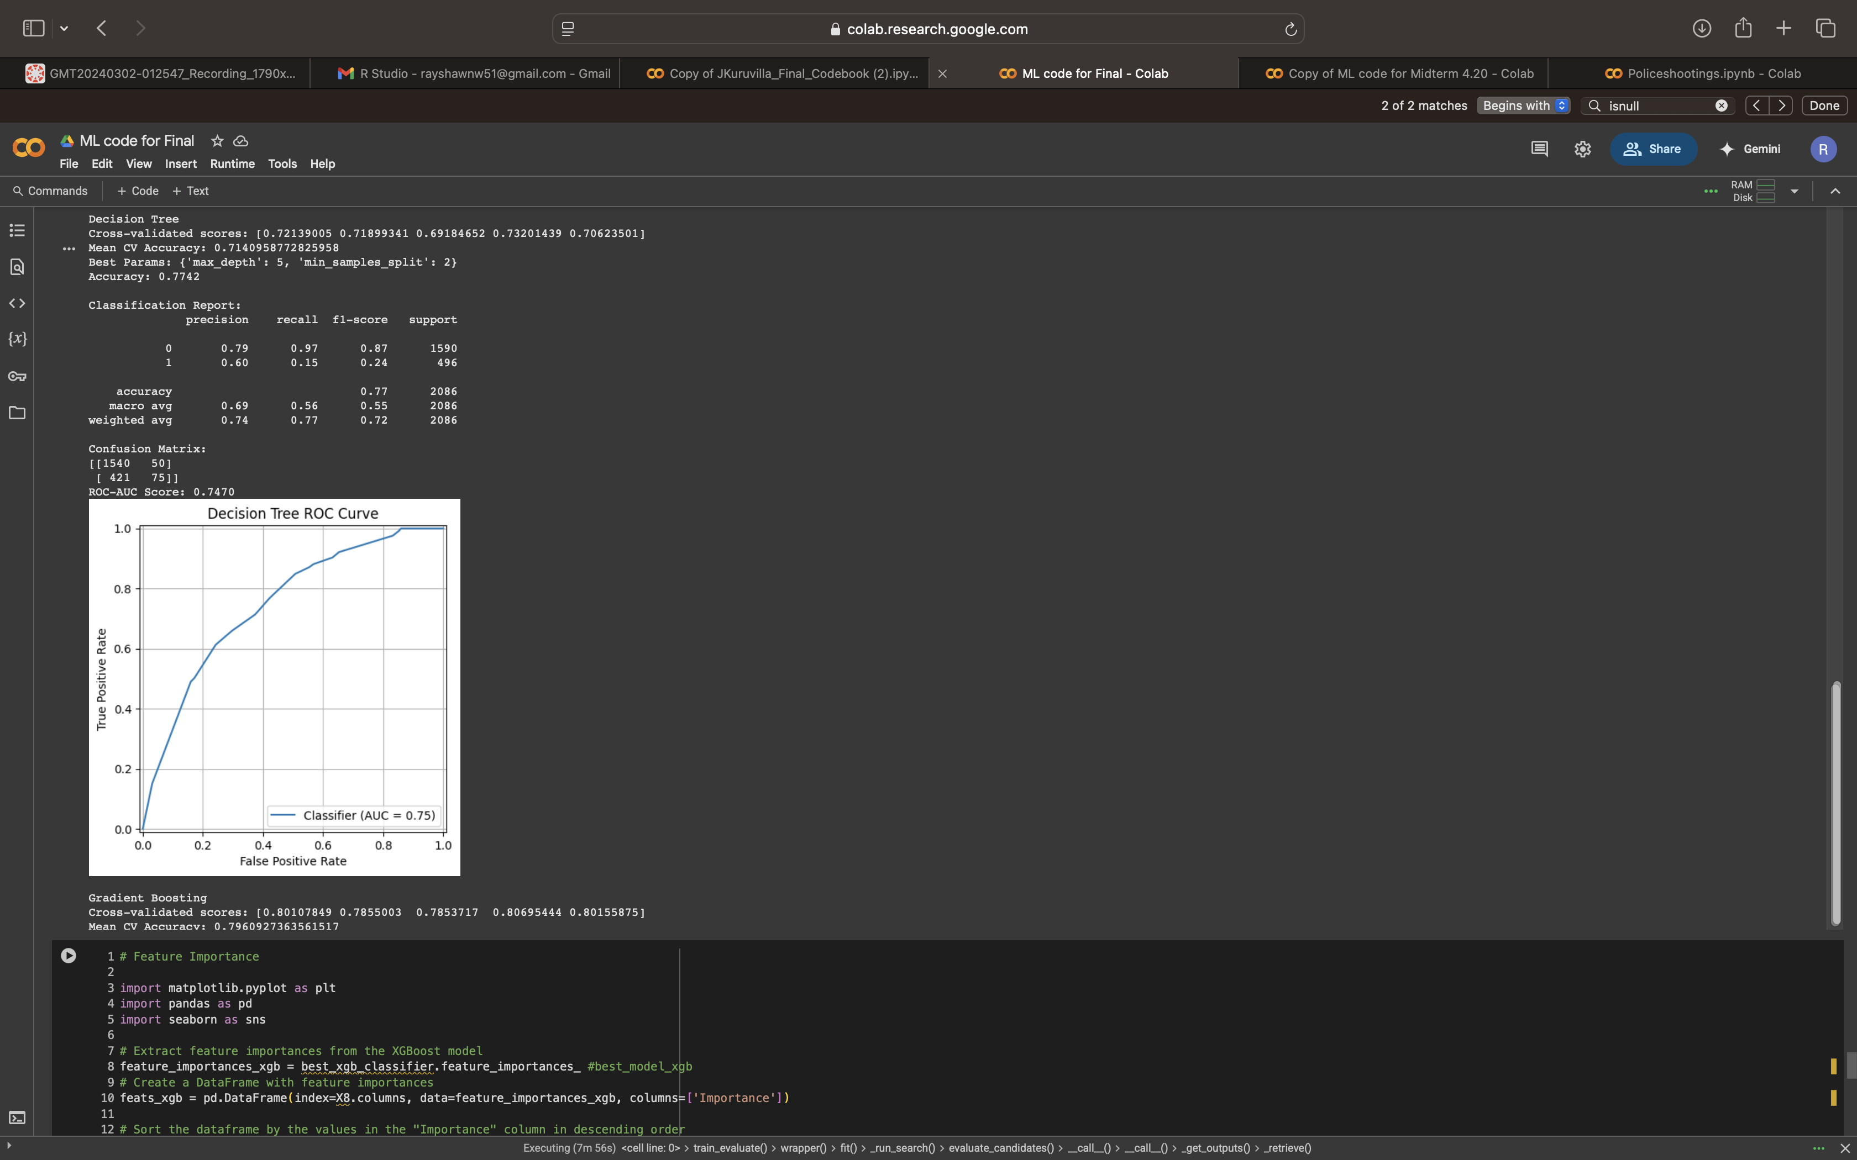
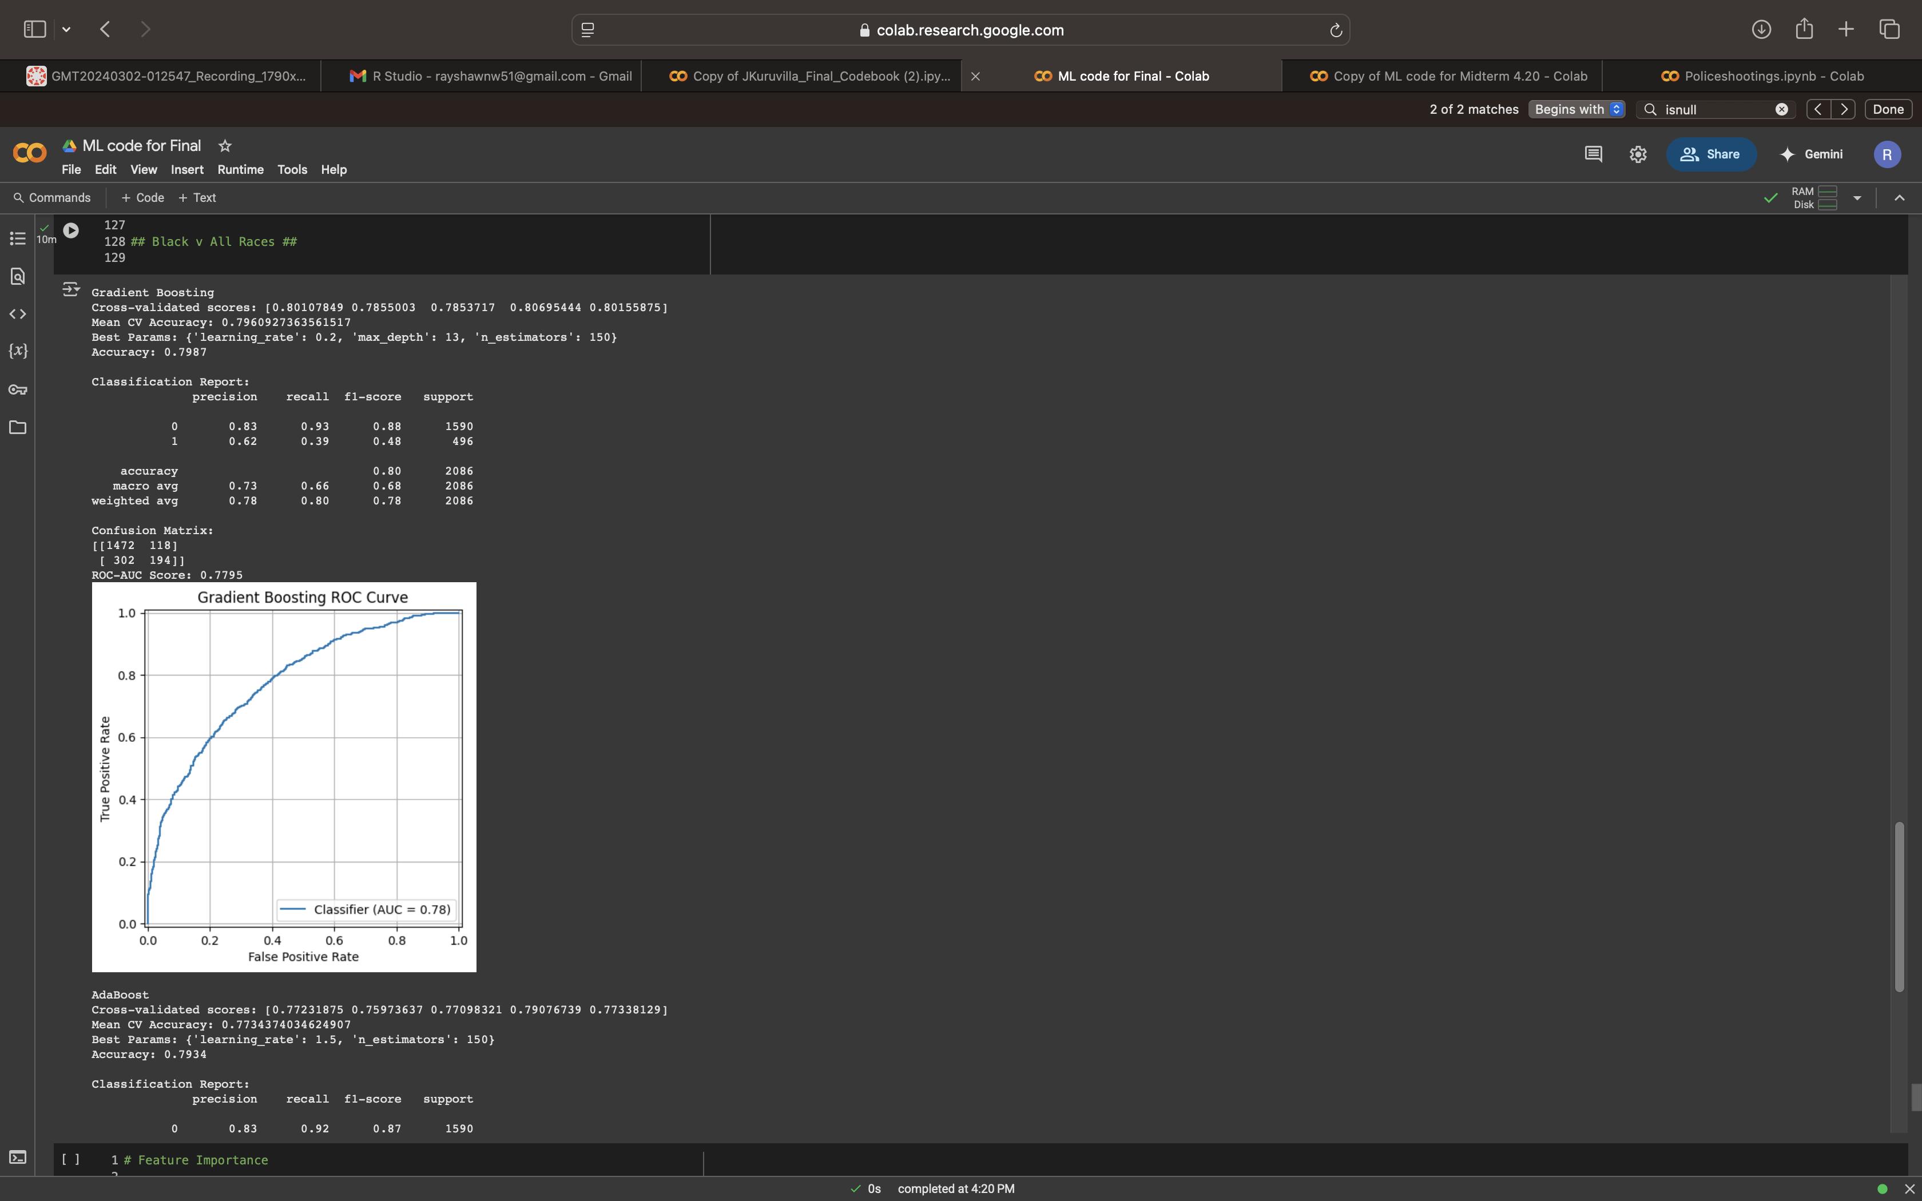
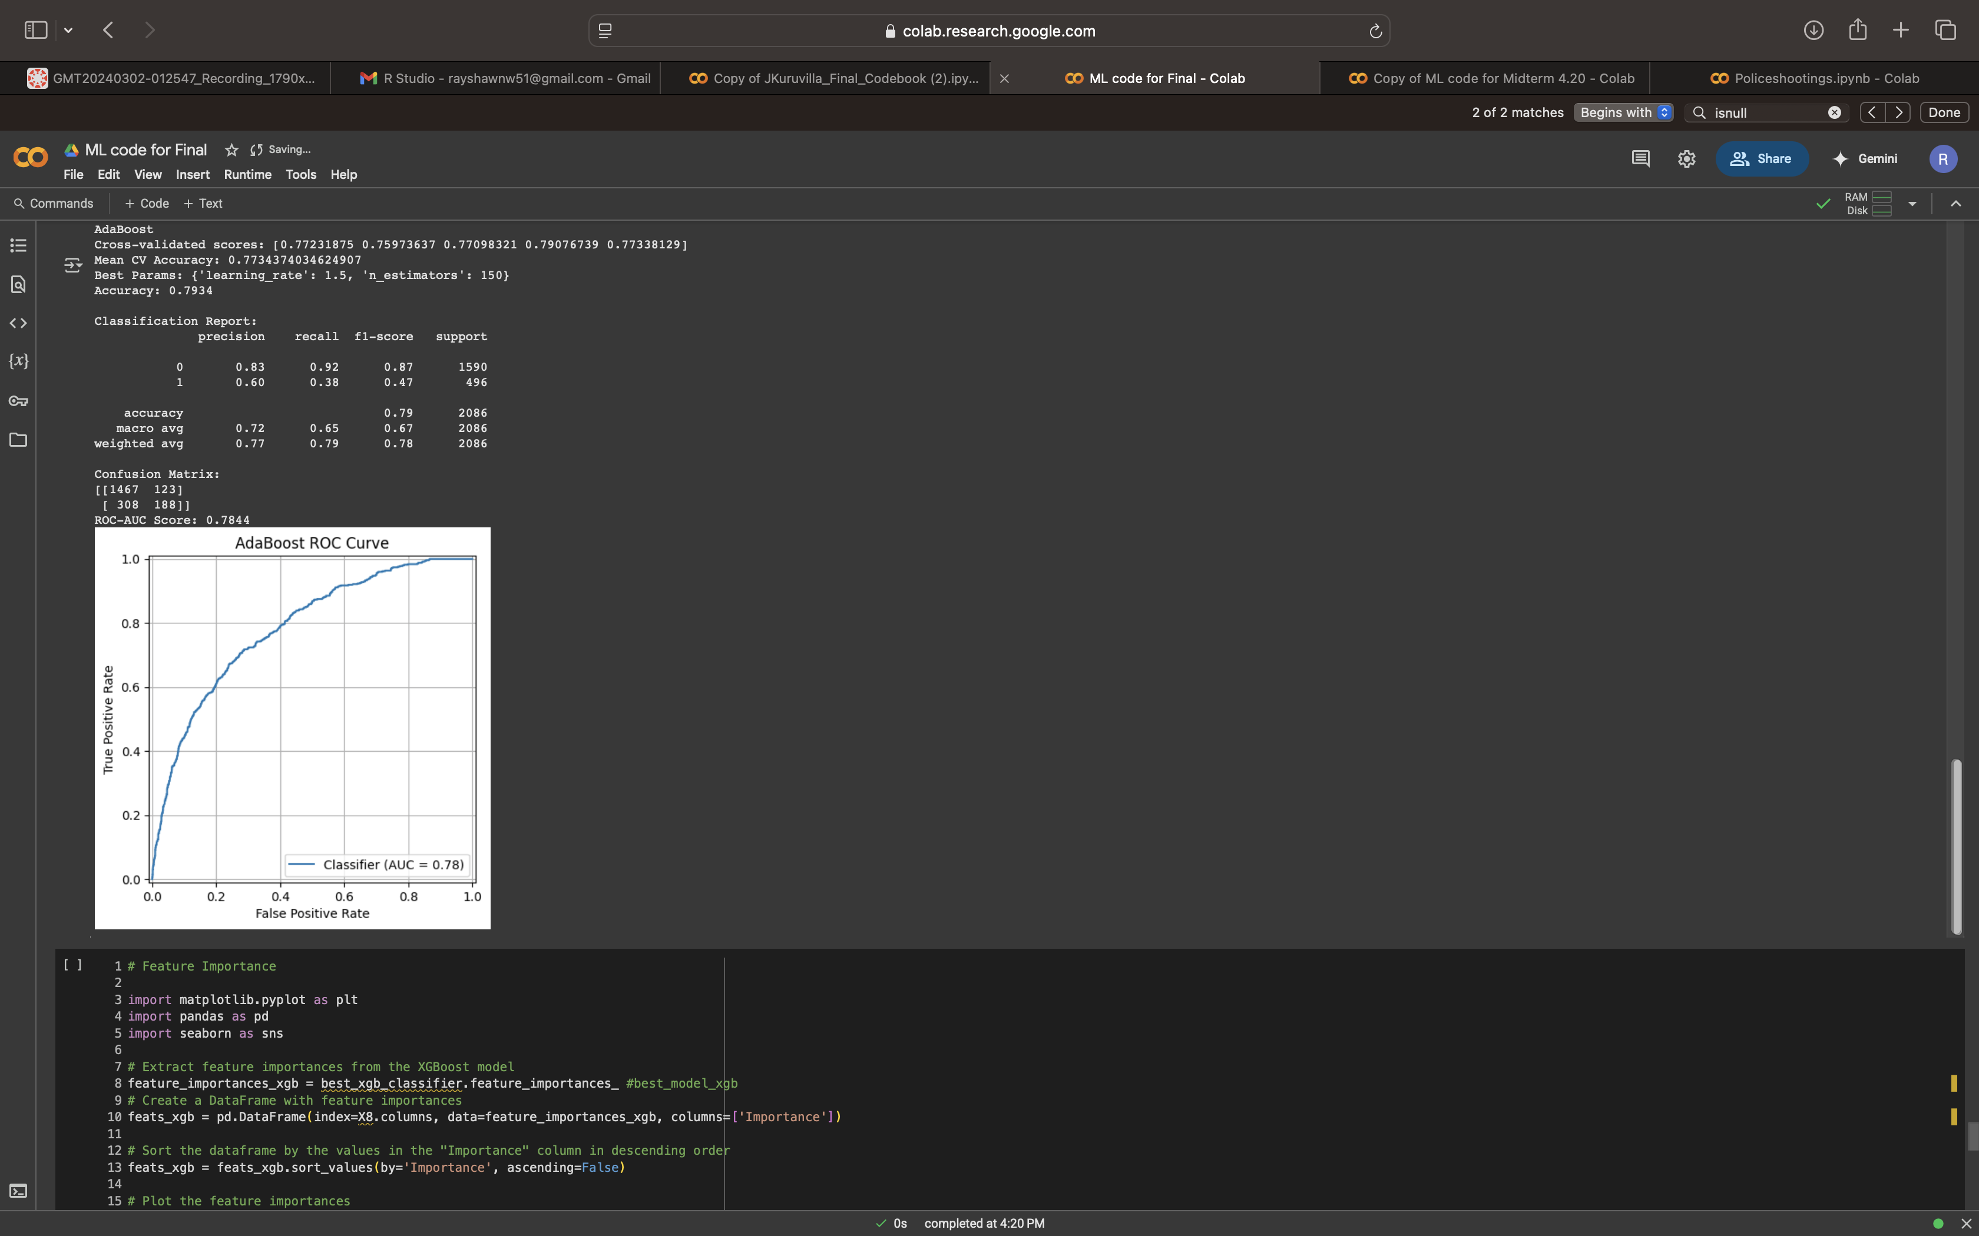
Post Grid search

Slide 25
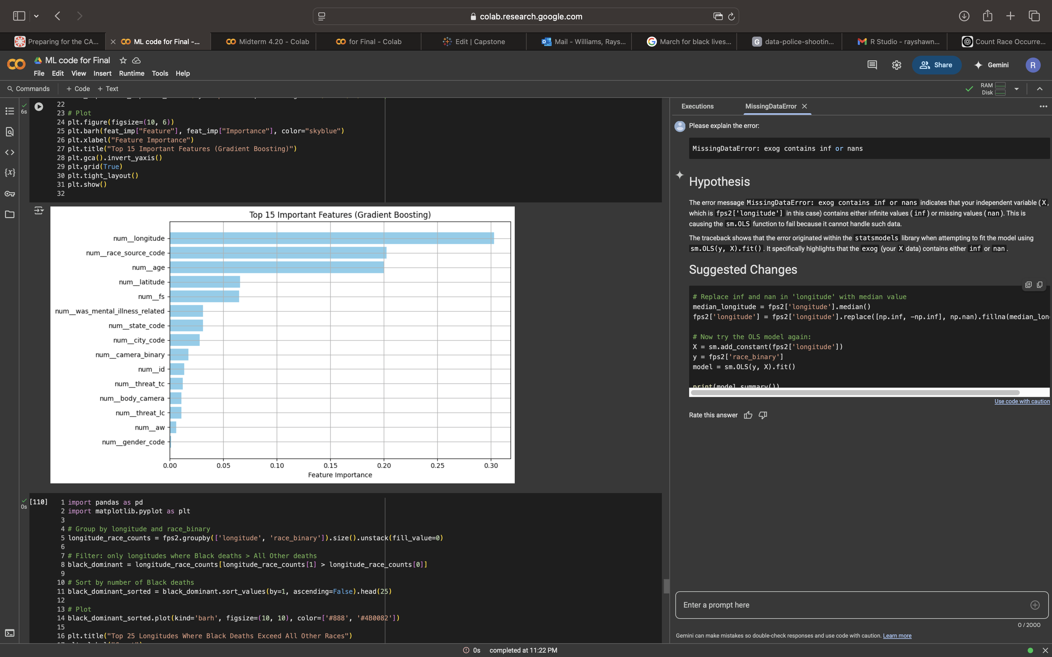
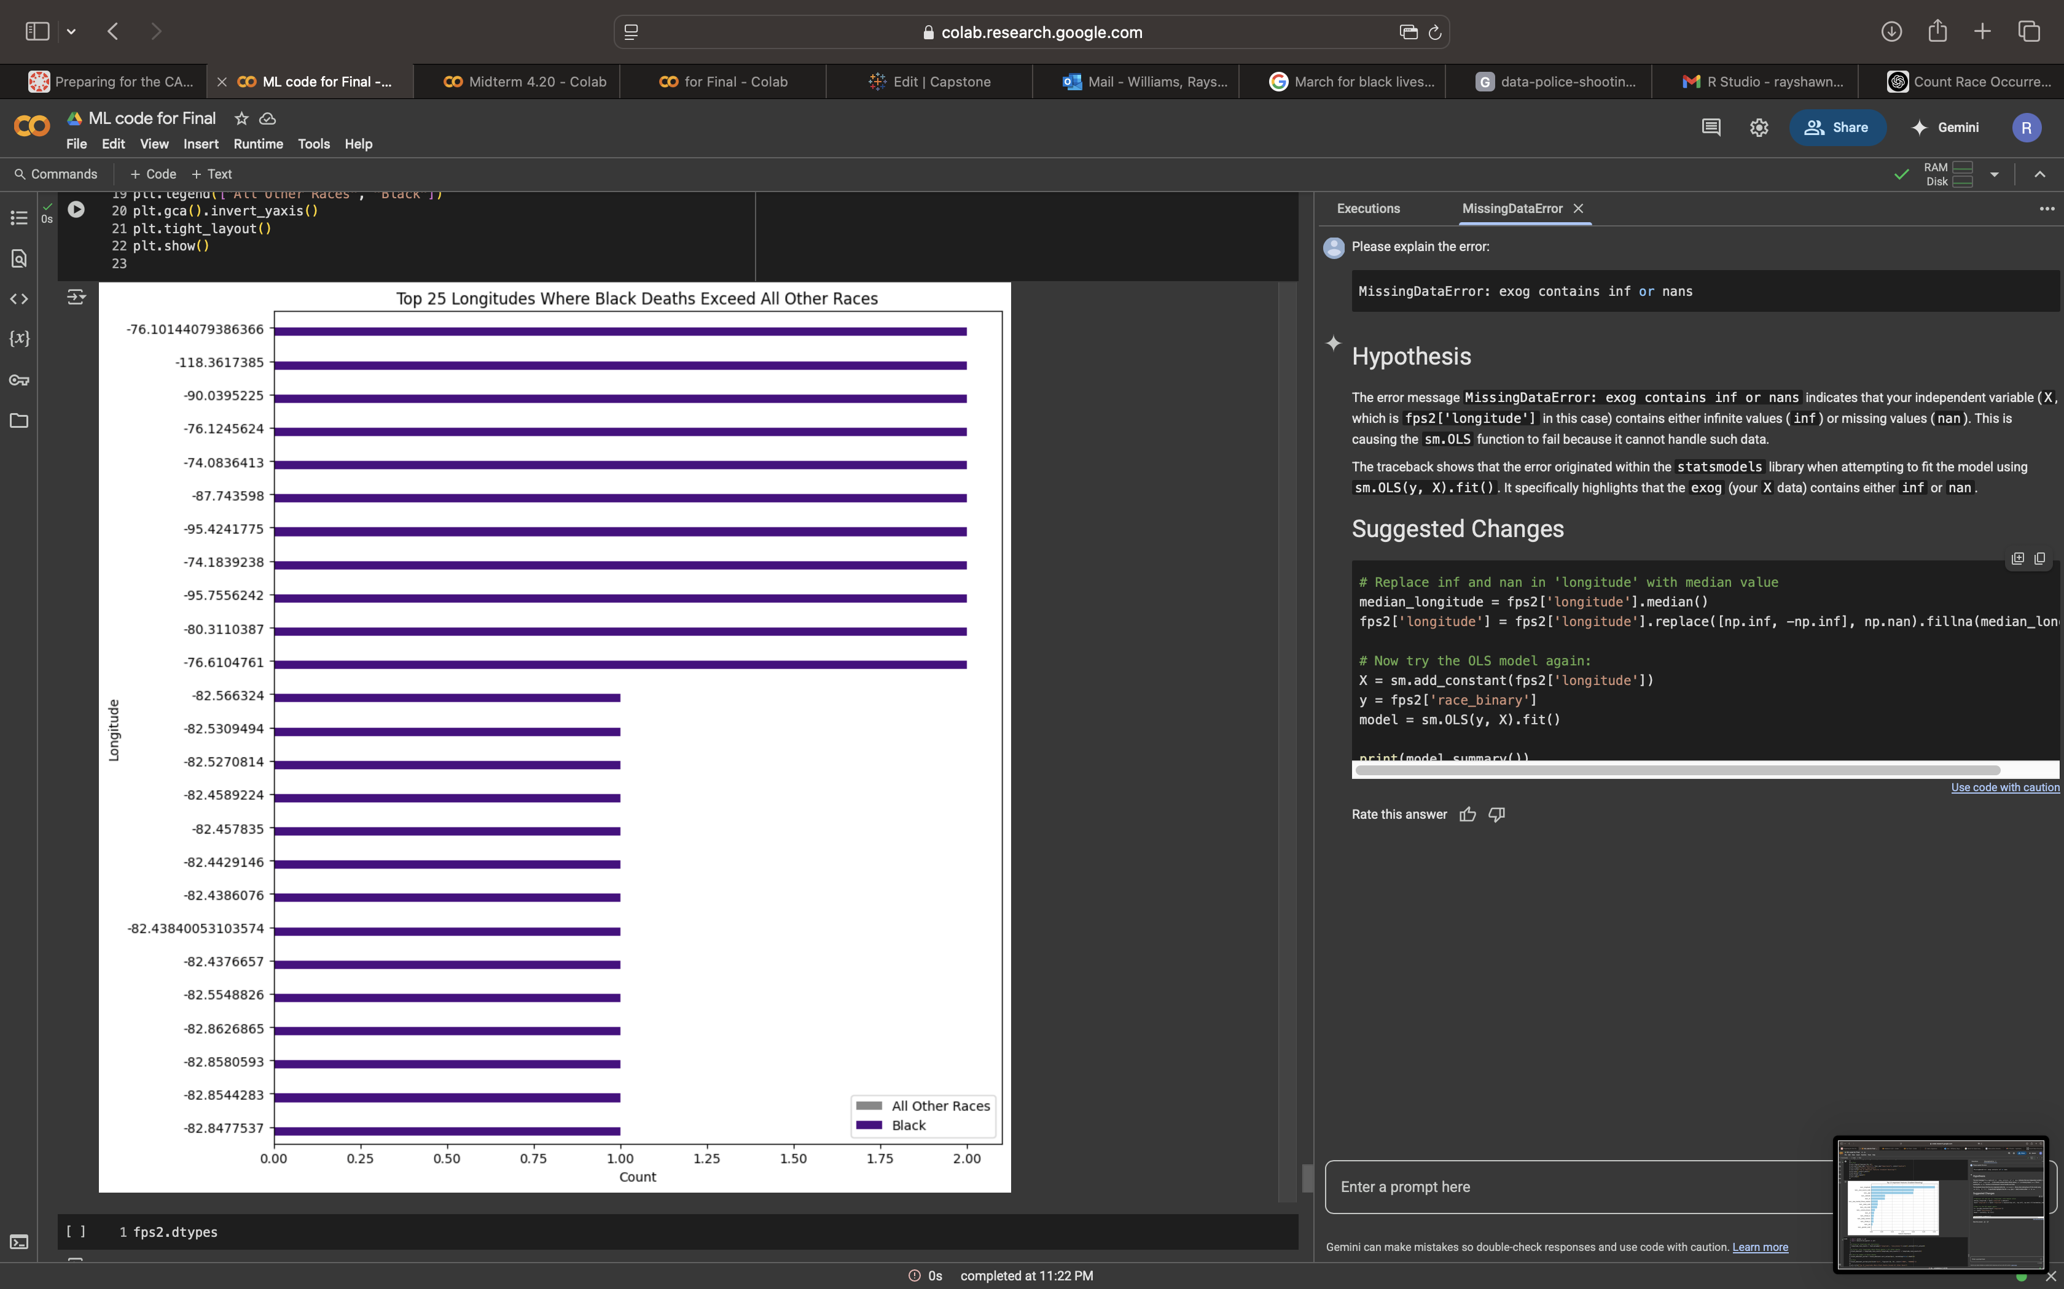
Feature Importance

Slide 26

Gaps and limitations
Studies primarily focus on deaths, ignoring non-fatal uses of force (e.g., excessive physical force, tasers).
Limited data on police accountability, convictions, or policy changes post-incident.
Some studies show cameras reduce overall use of force but do not significantly alter racial patterns.
Imbalanced dataset
There's potential for misinterpretation or misuse of findings if not framed carefully.
The data set does not include populations for the years

Slide 27
Closing
The overall finding shows that black people are killed at a disproportionate rate compared to white people in particular when analyzing through a probability lens. The data shows me that areas such as California over police certain areas which are the same areas that received extreme attention during the war on drugs based on the longitude. An important discovery I found in my data was the fatality gap of lives lost when body cameras were worn and on. The use of body cameras alone make a more than a 50% fatality rate difference in police stops. Overall longitudes near war on violence areas, not attempting to flee, carrying a gun between ages 27 and 37 are things that raise probability of a fatal encounter.

Slide 28
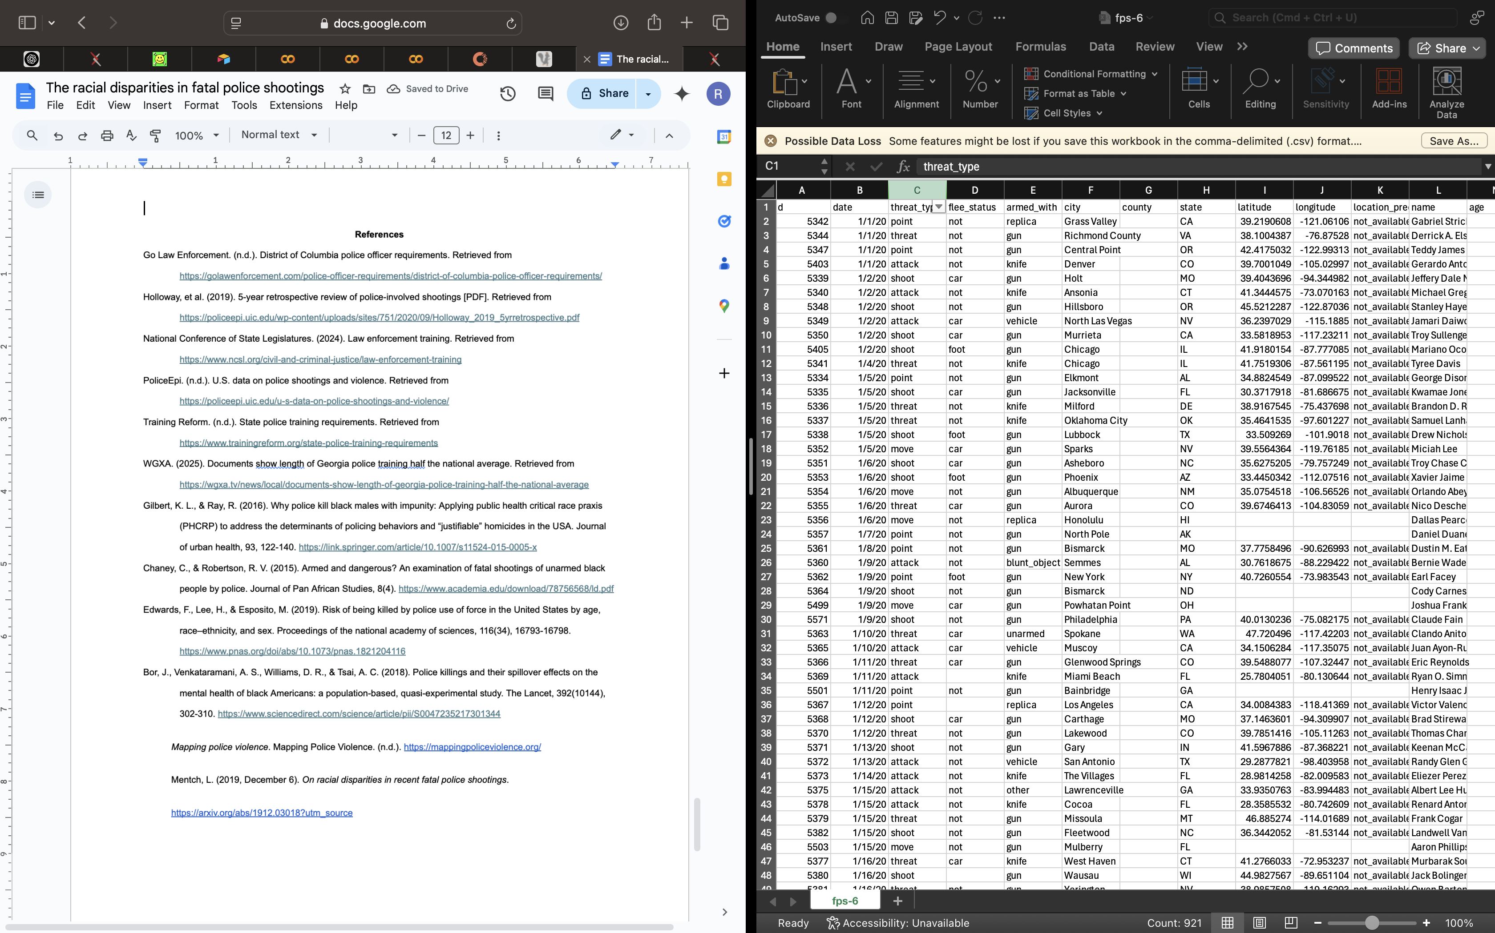
References

Slide 29

Questions

